Slide 1
The Harriet Lane Pediatric Residency Program Health Equity and Advocacy Track

Slide 2
What is Health Equity? Why does it matter?

Slide 3
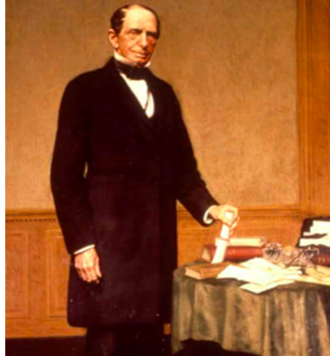
It is my wish that the plan...shall provide for a hospital, which shall, in construction and arrangement, compare favorably with any institution of like character in this country or in Europe...
The indigent sick of this city and its environs, without regard to sex, age, or color, who may require surgical or medical treatment, and who can be received into the hospital…and the poor of this city and state, of all races, who are stricken down by any casualty, shall be received into the hospital, without charge.
- Johns Hopkins, 1873

Slide 4
Hopkins Pediatric Health Equity & Advocacy Track
We envision a world where every child, regardless of their background, has the opportunity to reach their full potential.
We aim to train pediatric leaders who will work to eliminate health disparities through advocacy, research, community partnership, education, and clinical care.
The program will leverage resources across Johns Hopkins to provide graduates with a unique skill set that will equip them to make an impact for children affected by health disparities.

Slide 5
Hopkins Pediatric Health Equity & Advocacy Track
Overarching goal is to train pediatric leaders who will work to promote health equity through advocacy, research, community partnership, education, and clinical care.
To increase knowledge related to social determinants of health and health disparities in pediatric populations
To learn about the role of community partnership and advocacy in promoting health equity
To develop skills in culturally competent clinical care
To engage in scholarship related to health equity

Slide 6
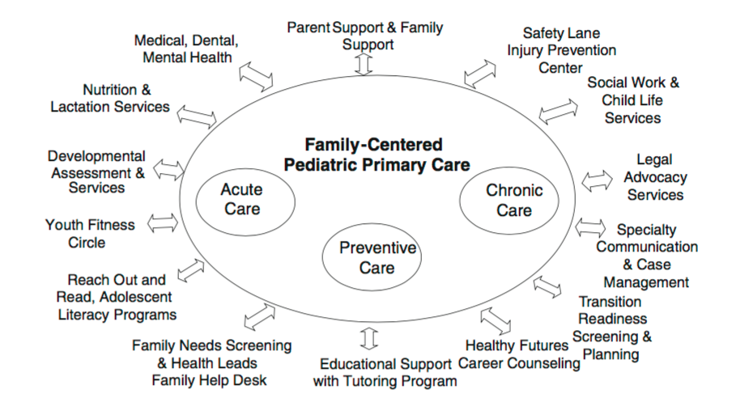
Harriet Lane Clinic
Continuous
Comprehensive
Coordinated
Compassionate
Culturally Effective
Cheng T & Solomon B. Mat Child Health J Feb 2014

Slide 7
Capstone project in coordination with mentors with dedicated time
Facilitate presentation at regional/national meetings
Scholarship
Courses at JHBSPH
Advocacy rotations
Community experiences
Electives with health equity focus
Advocacy & Skill Building
Longitudinal track mentor(s) from Hopkins Faculty
Linking to institutional resources
Individualized learning plan
Mentorship

Slide 8
1-2 months of elective time dedicated to Health Equity individualized learning plan
Complete capstone project
Attend national meeting
PGY3
1-2 months of elective time dedicated to Health Equity individualized learning plan
Begin capstone project
Global Health Equity Elective- 2 weeks
PGY2
Health Equity selective – 1 mo Spring
Online Course at JHBSPH Local and Global Best Practices in Health Equity Research Methods
Choose capstone project topic
PGY1
Throughout residency:
Scholarship
Half-days
Elec, ED
Avg 6 per 6 mo starting after Jan
Center for Equity
Longitudinal Social Determinants
of Health Curriculum
Urban Health
Academic Half Days
Noon Conf Once/Month
JC and Book Club
Serve on Health Equity Track Advisory Board
Meetings with
Content Experts

Slide 9
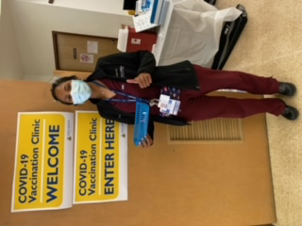
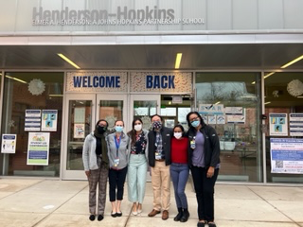
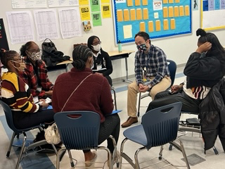
Community Engagement Experiences

Slide 10
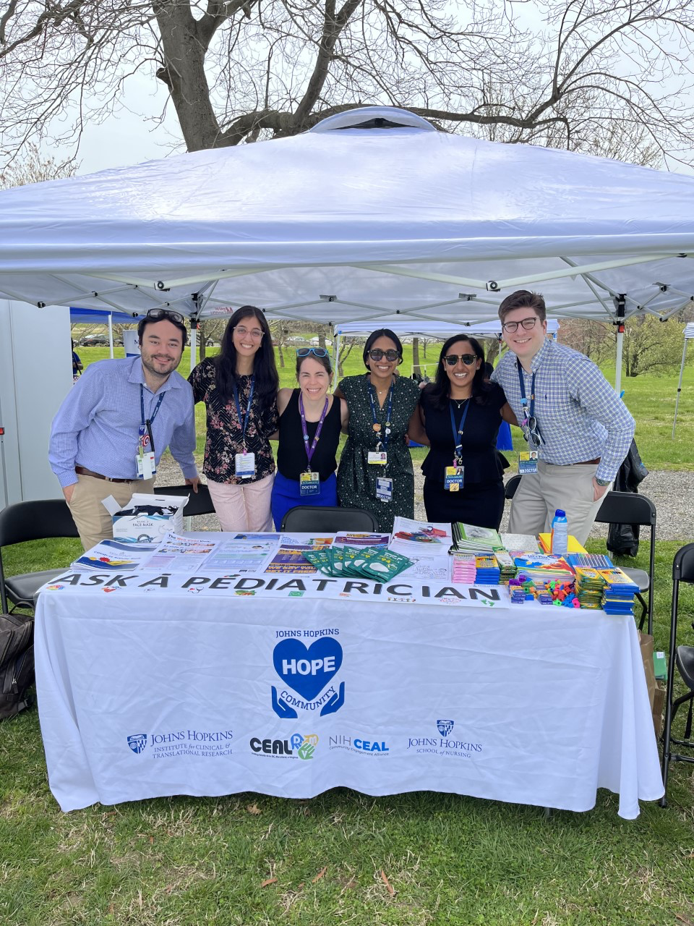
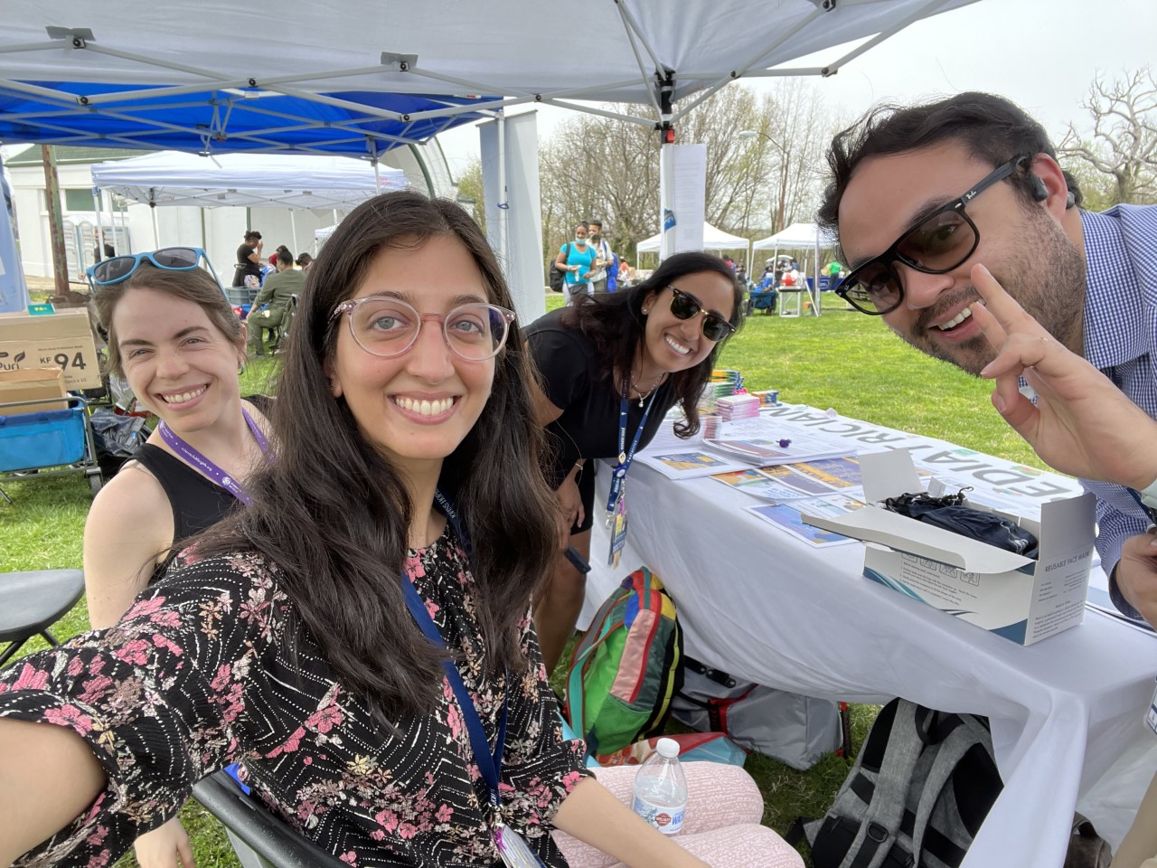
Community Engagement Experiences

Slide 11
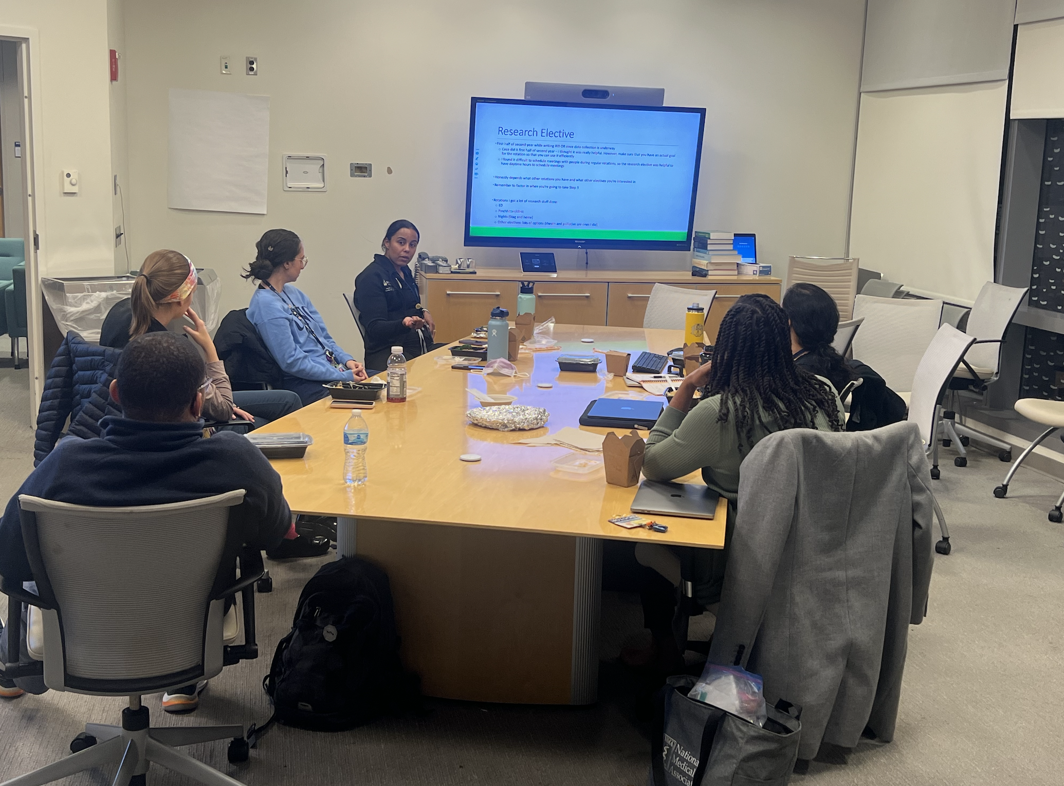
Research In Progress

Slide 12
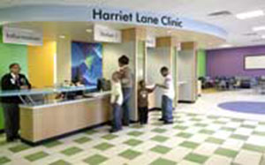
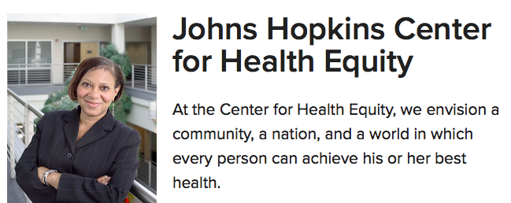

Slide 13
Hopkins Pediatric Health Equity Track
The track will leverage relationships and collaborations across the department and the institution including:
Johns Hopkins School of Medicine
The Center for Child and Community Health Research
Centro Sol – Center for Salud Health & Opportunities for Latinos
Center for Transgender Health
Rales Center for the Integration of Health and Education
Johns Hopkins University
Center for Health Equity
Urban Health Institute
Bloomberg School of Public Health
Bloomberg American Health Initiative
Center for Adolescent Health
Center for Gun Policy and Research
Center for Injury Research and Policy
Center for Prevention of Youth Violence
The Child and Adolescent Health Measurement Initiative
Department of Population, Family, and Reproductive Health

Slide 14
Meet Our Residents

Slide 15
Mikaela Gold, MD PGY-1
Hometown: Huntsville, Alabama
Med School: Meharry Medical College
Why Hopkins HEA: I was specifically looking for a program that extends beyond the classroom and is deeply integrated into the community, providing intentional mentorship and fostering collaboration across various organizations. The disparities in pediatric health outcomes across specialties within the Black community are alarming. As a Health Equity and Advocacy resident, I will be equipped to address the social determinants of health that create barriers to equitable healthcare through a multifaceted approach involving health equity research, community engagement, and ongoing advocacy. I am also excited to gain additional expertise through the Johns Hopkins Bloomberg School of Public Health and to participate in national advocacy efforts with the American Academy of Pediatrics.
Health Equity Interests: Health disparities in infant mortality rates, Social determinants of health

Slide 16
Pranav Nandan, MD PGY-1
Hometown: Blue Bell, PA
Med School: Saint Louis University
Why Hopkins HEA: I strongly believe that the health of a child is inseparable from the health of their community. Through the HEA track, I felt that I would have the dedicated time and opportunities to positively impact the Baltimore community on both an individual and systemic level. Learning from the incredible mentors at Hopkins, I was confident I would leave this program a much stronger leader and physician-scholar.
Health Equity Interests: food access, immigrant/refugee healthcare, preventing hospitalizations

Slide 17
Jaz Johnson, MD: PGY-2
Hometown: Newport News, VA
Medical School: Virginia Commonwealth University
Why did you choose Hopkins? Hopkins has always been a dream of mine, since I was a kid I dreamed of coming here. Of course you have the history and the legacy - but the thing that really blew me away was the faculty. It's hard to explain but I really felt seen, and wanted. This all started when I called one of the APDs to notify them of my inability to participate in the virtual visiting elective because of scheduling conflicts - without even seeing my full application I was offered an in-person away rotation. I was blown away by that!! I ultimately declined because I felt I didn't have the bandwidth but it spoke volumes to how serious they were about recruiting URiM students, which means a lot as an African-American male. This coupled with an incredible interview experience, great resident socials and the world-class training (as a resident and within the Health equity track), made Johns Hopkins the right choice for me!
Health equity interests: healthcare access for youth in the juvenile justice system

Slide 18
Molly Kuehn, MD: PGY-2
Hometown: Coralville, IA
Med school: Duke University School of Medicine
For fun: Garden, read, make photo books, watch sports, and spend time outdoors, especially near water
Why did I choose Hopkins: A couple reasons I chose Hopkins are the strength of clinical training and the opportunities for community partnership and advocacy through the Health Equity track
Health equity interests: obesity, primary care delivery

Slide 19
Rafi Faria, MD: PGY-3
Hometown: Nova Friburgo, Brazil & Deerfield Beach, Florida
Med School: UNC Chapel Hill
Why Hopkins HE: To me, being a great pediatrician means knowing everything I can about addressing health inequities and understanding how to apply that knowledge in a practical way in my day-to-day life as a physician. I wanted a program where Health Equity was built into the structure of the program itself as well as the hospital system. There are so many resources to address inequities built into the way we learn to care for patients here and learning to make those connections in residency is invaluable.
Health Equity Interests: Food insecurity (especially the availability of healthy foods), Hispanic/Latino healthcare, disparities in kidney transplants/chronic kidney disease

Slide 20
Cecilia Di Caprio, MD, MPH: PGY-3
Hometown: Minneapolis, MN
Medical School: University of Minnesota Medical School
Relevant Experiences: AmeriCorps City Year, SNAP-Ed Community Educator, MPH in Public Health Nutrition
Why Hopkins HE- I was looking for a program that would allow me to have dedicated time to engage in health equity work and learn from incredible mentors in the field. I am not sure what I want to do after residency, so I was grateful to find a program that was not specifically tied to primary care, and would allow me to apply my interests in health equity to whatever career path I end up choosing.
HE interests: Examination of social support as a positive social determinant of health; Reproductive justice

Slide 21
Alumni
Tai Hairston, MD
Medical School: Johns Hopkins School of Medicine
Health Equity Interest:
- High acuity trauma during the COVID19 era compared to previous years, especially looking at child abuse and assaults in lower SES zip codes of Baltimore
- Neonatal Abstinence Syndrome- Increasing parental engagement
Why Hopkins: I truly found a 'home' in the Pediatrics Department at Johns Hopkins as a medical student. Many attendings and residents I had a chance to work with not only taught me the skill of observation needed in pediatric medicine but also how to identify and combat the social determinants of health in the children we cared for
Where are they now: Johns Hopkins Pediatric Hospitalist Fellow, Chief Resident 2024-2025
Tai Hairston MD

Slide 22
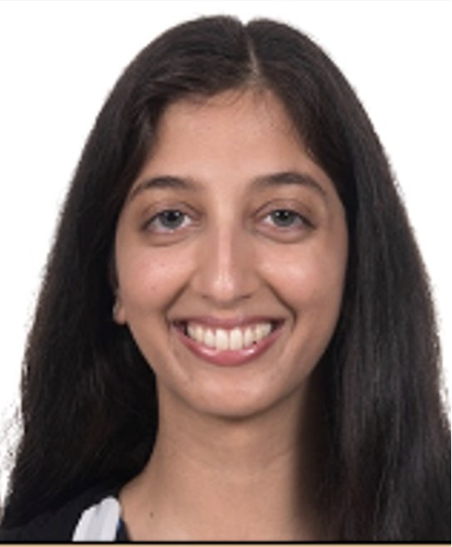
Devki Gami MD, MA
Medical School: Temple University
Additional Training: Master Degree in Urban Bioethics
Relevant Experience: City Year AmeriCorps
Health Equity Interest: School-based health centers
Where Now: General Pediatrics Pennsylvania

Slide 23
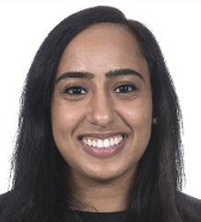
Maneesha Sakhuja MD, MPH
Medical School: University of Nevada​
Additional Training: MPH from Johns Hopkins Bloomberg School of Public Health
Relevant Experience: Staff member on a federal advisory committee on bioethics
Health Equity Interest: Intersection of public health, ethics, and policy, language equity ​
Where now: CNMC Hospitalist and Hopkins Ethics Fellow
​

Slide 24
Medical School: George Washington University School of Medicine
Relevant Life Experiences: Teacher and New York Center for Childhood Development
Health Equity Interest: Barriers to care management among teens with chronic kidney disease
Why Hopkins: Dedicated time and space to think about and work towards addressing issues related to health equity. The HE track creates a home base for me that continues to remind me of my broader interests and helps me maintain perspective. I also like that the track is non-binding in terms of career choices (e.g, it is not a strictly primary care track).
Where are they now: CHOP Hospitalist
Amali Gunawardana MD

Slide 25
Medical School: SUNY Downstate
Additional Training: MPH Health Policy and Management
Health Equity Interest: Legislative advocacy - qualitative research project interviewing youth to elucidate perspectives surrounding voting.
Why Health Equity: I'd love to combine my work as a pediatrician with community advocacy and non-fiction writing, like composing op-eds for newspapers and elevating patient voices to catalyze policy change.
Where are they now? Pediatric EM Physician at Howard County Hospital
Melissa Hirsch MD, MPH

Slide 26
Medical School: Boston University
Health Equity Interest: immigrant and refugee health and medical education. I am working on a retrospective analysis of patients who attend the Mobile Care-a-Van Clinic.
Why Hopkins: I was impressed by the track leadership and their vision for the program, the chance get support and protected time for advocacy and whatever my eventual project direction would be, and the flexibility the track offered me to pursue a variety of career interest during residency.
Where are they now? CHOP Hospitalist
Dan Sylvester MD

Slide 27
Residents Making Waves in Health Disparities and Inequities Research
Rafi – PGY-3
Recipient of 2023 Idoreyin P. Montague Community Action Award
APA New Century Scholar- Academic Medicine
Jaz-Munn Johnson, PGY-2
National Medical Association – Renee Jenkins Award
Alumni Awards:
Amali
-Best Research Project Johns Hopkins Scholarly Achievement Day 2022. Baltimore MD
- Abstract acceptance- American Academy of Pediatrics Experience National Conference 2022, Anaheim, CA
Tai
-Renae Jenkins Research Symposium Award, National Medical Association 2021
- Platform Presentation," COVID-10 Trauma and Health Disparities" National Medical Association Convention 2021
- Platform Presentation," COVID-10 Trauma and Health Disparities" Society for Academic Emergency Medicine 2021
Poster Presentation. " COVID-10 Trauma and Health Disparities". Pediatric Academic Society 2021
Maneesha & Devki
-Recipient of the Health Equity Grant, AAP Section on Pediatric Trainees "Family-Controlled Interpretation Access to Improve Language Equity in Pediatric Primary Care Clinics."
-Abstract acceptance – APHA National Conference
-Abstract acceptance- American Academy of Pediatrics Experience National Conference 2023, Washington, DC

Slide 28
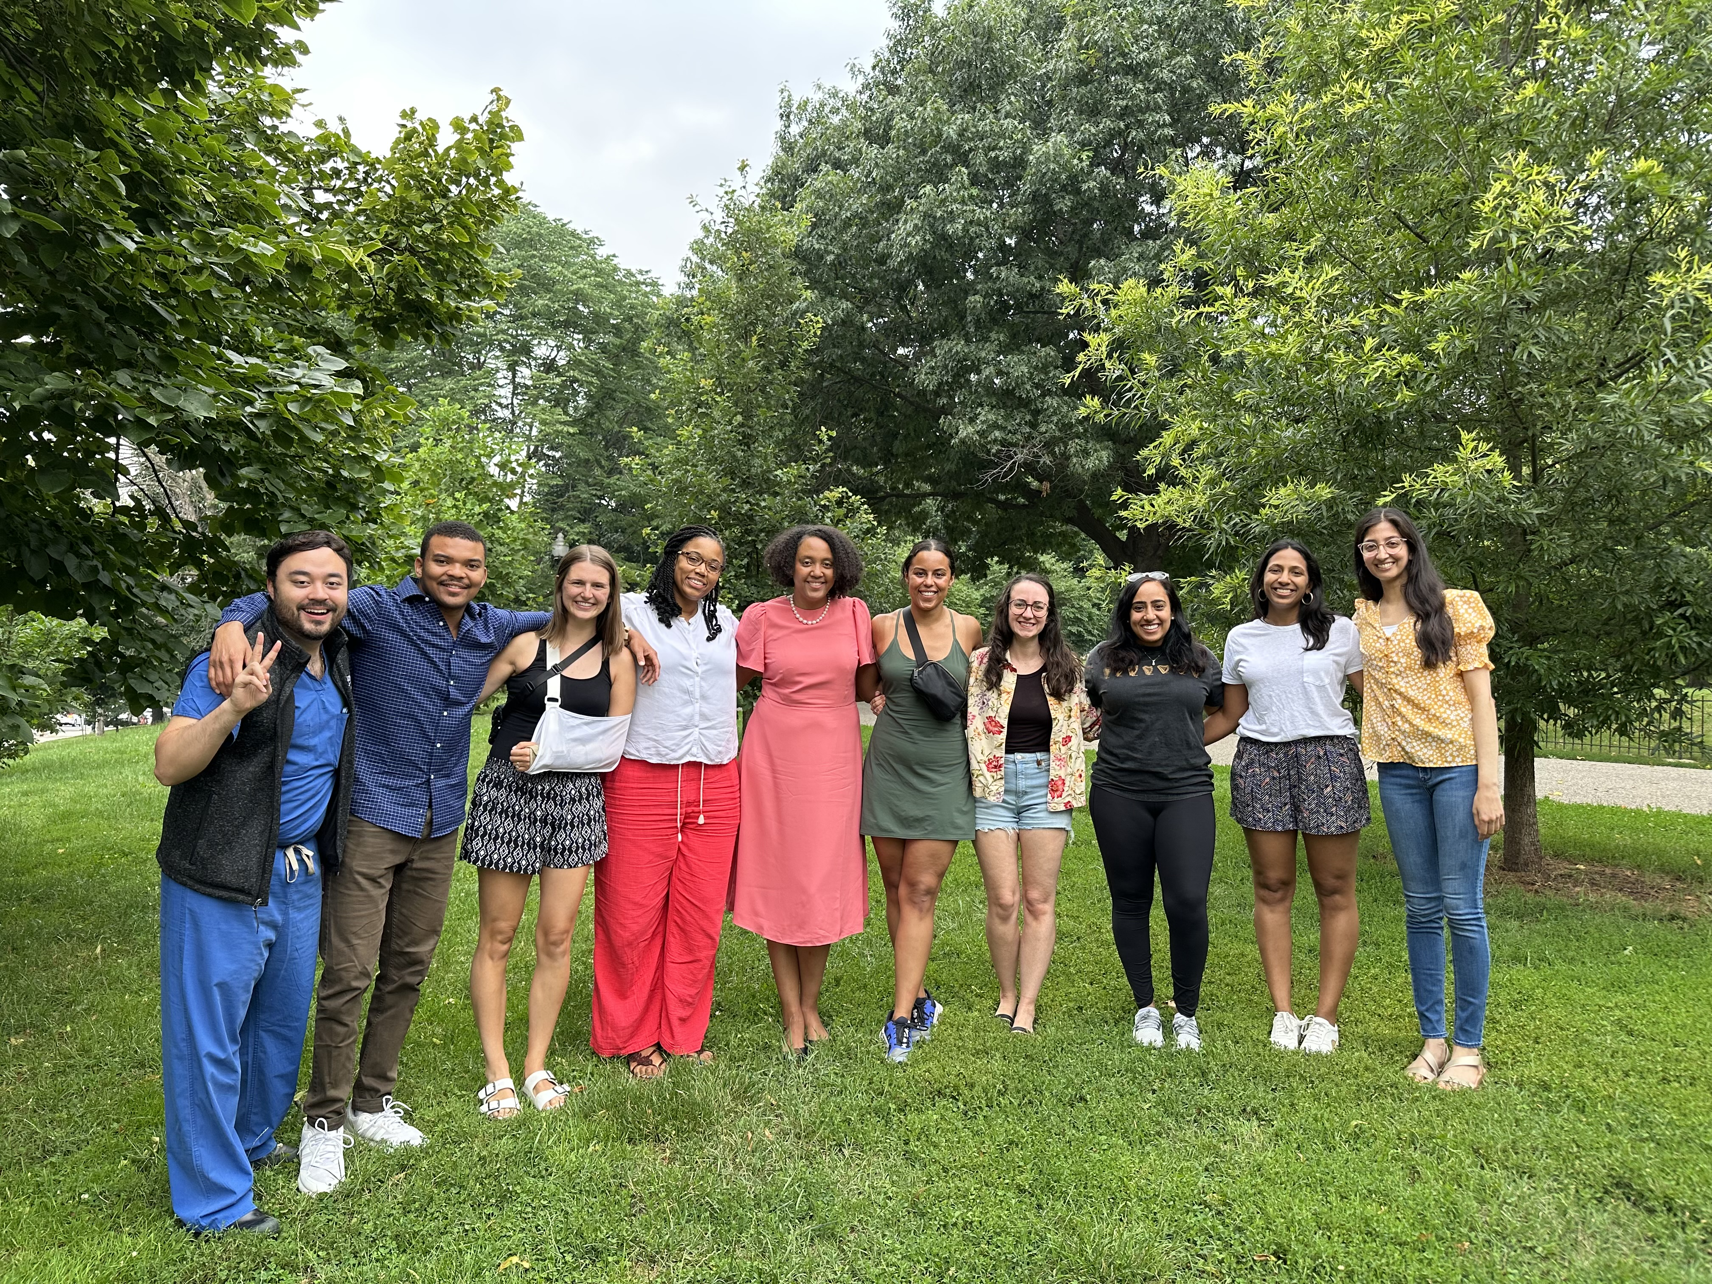
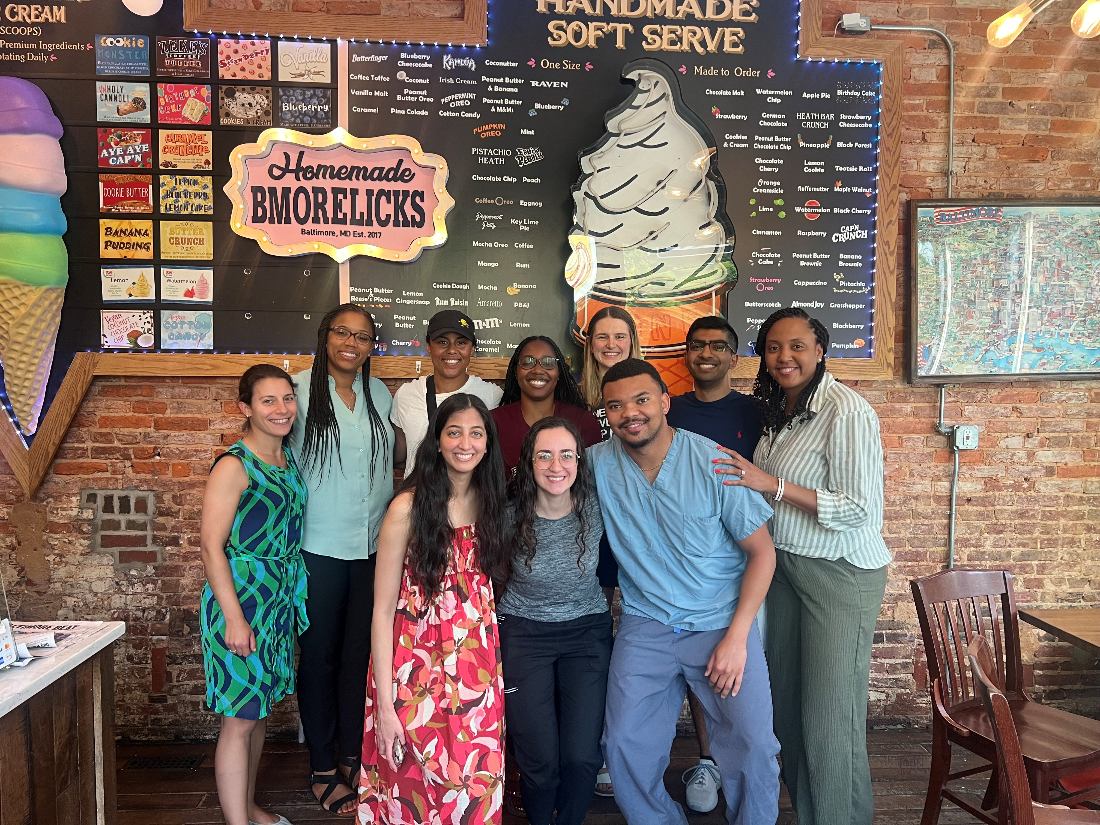
The Harriet Lane Pediatric Residency Program Health Equity and Advocacy Track- Join Us!

Slide 29
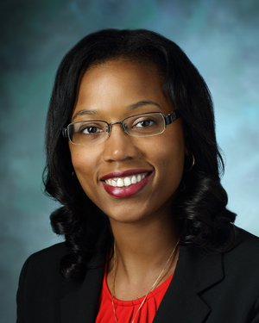
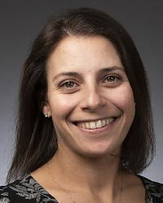
Questions?
Marquita Genies, MD MPH
APD, Pediatric Residency Training
Health Equity and Advocacy Track Co-Director
Assistant Professor of Pediatrics
Assistant Dean GME- DEI
Division of Pediatric Hospital Medicine
Johns Hopkins University School of Medicine
Email: MGenies1@jhmi.edu
Rebecca Seltzer, MD MHS
Health Equity and Advocacy Track Co-Director
Assistant Professor of Pediatrics
Associate Faculty- Berman Institute of Bioethics
Division of General Pediatrics
Johns Hopkins University School of Medicine
Email: RSeltze2@jhmi.edu

