Slide 1
PGY-3 Class
2024-2025

Slide 2
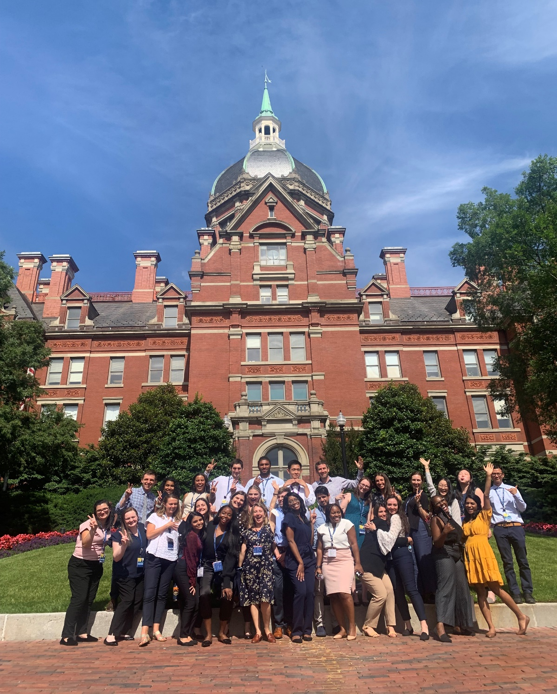
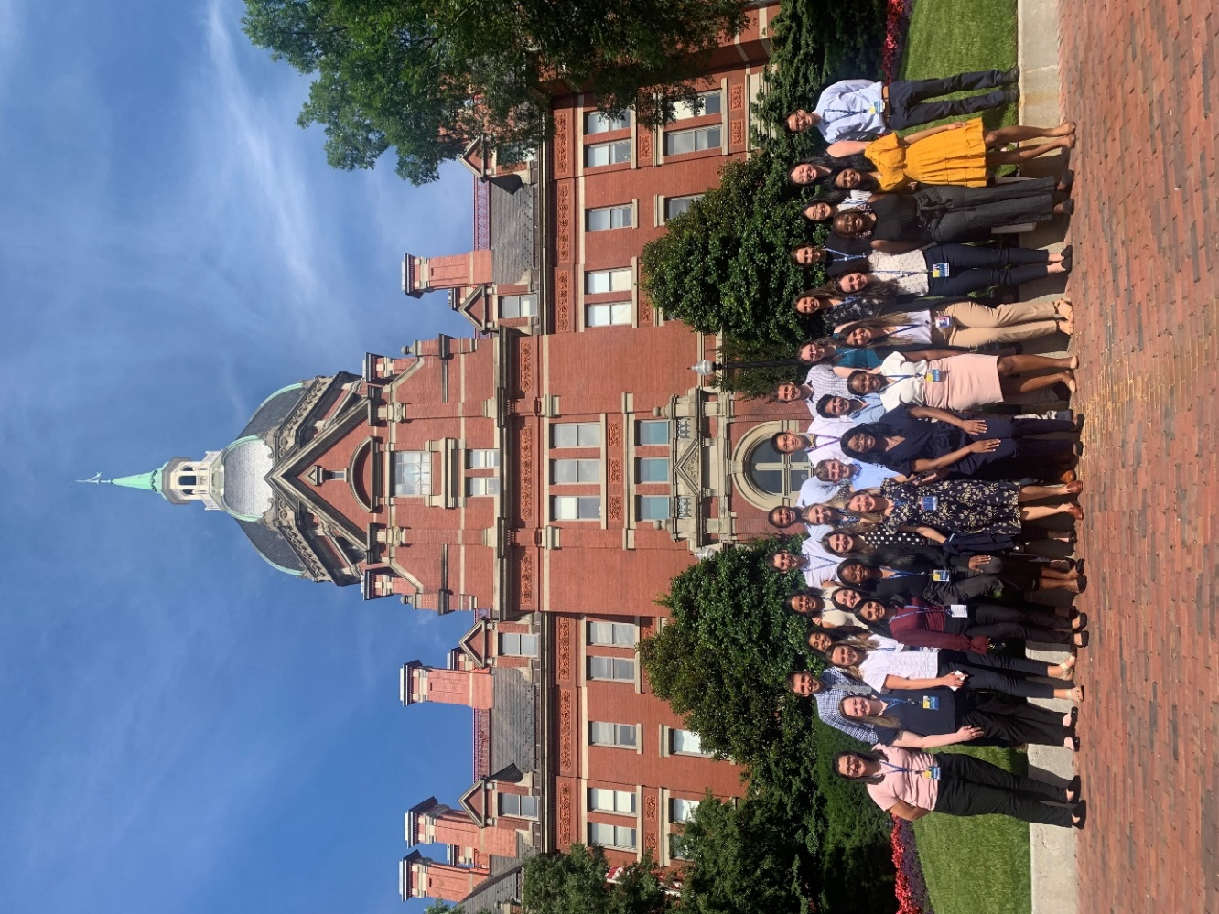

Slide 3
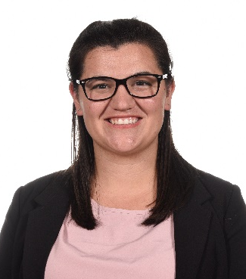
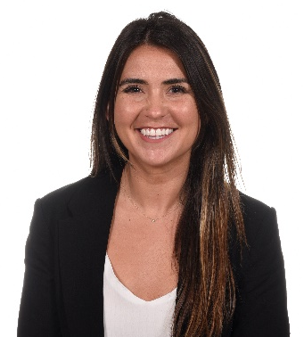
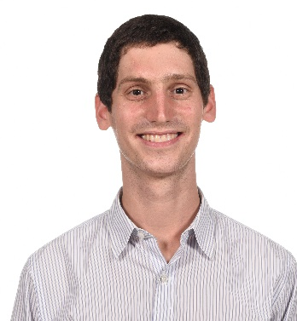
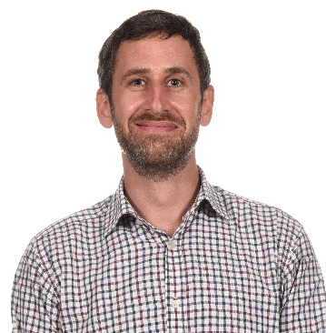
Ricci Allen M.D. M.Sc. | Sarah Benett M.D., M.S. | Alec Berman M.D. | David Berman M.D., M.Sc.
Hometown: Bradenton, FL
Medical School: University of Central Florida COM
For Fun I: I like to spend time with friends, try new yummy foods, and explore the DMV area with my significant other!
Why did you choose Hopkins: I chose Hopkins because I was so impressed with the emphasis that Hopkins places on learning and being a good teacher! The patient population is so diverse and there is groundbreaking research going on all of the time!
What excites you most about living in Baltimore: Baltimore excites me because of the food scene, living close to the harbor, and having my first winter in years. Not to mention, getting to eat yummy crabs!
She/Her
Hometown: Mountain View, California
Medical School: Medical College of Wisconsin
For Fun I: love to go on walks around the harbor, hang out with friends, go hiking, and try new restaurants in Baltimore.
Why did you choose Hopkins: After my interview day, I knew this was the program for me. I loved the opportunity to care for some of the sickest kids in the country while also being the main provider and advocate for the Baltimore community. I felt very supported by the program and immediately felt welcomed by the residents. As someone who is very interested in global and public health, I loved the endless opportunities to work abroad and be educated by some of the best global and public health physicians in the country.
What excites you most about living in Baltimore? The Baltimore food scene is incredible!! I'm also really excited to live close to the water, explore the farmers markets, be near old friends, and be within two hours of family in DC and Philadelphia.
She/Her
Hometown: Hastings-on-Hudson, NY
Medical School: Oregon Health & Science University
For Fun: Vegetable Farming, Cooking, Reading Fiction, Dog Ownership, Running, Bike Commuting
Why did you choose Hopkins: I got the overwhelming sense on my interview day that the pediatrics community would nurture me both intellectually and personally. I have felt so welcome here since day 1 and cannot imagine a better group of smart, kind and caring people to train under and alongside. The culture of teaching here is incredible, as is the support I feel to grow, make mistakes and be myself. I could not be happier at Hopkins!
What excites you most about living in Baltimore: Baltimore is amazing. Coming from the northwest, I was surprised by how much terrific hiking there is just 10-20 minutes away. My partner and I both love how easy it is to get into nature with my energetic dog. And to enjoy all the perks of a vibrant, young, fun city!
He/Him
Hometown: Baltimore, MD
Medical School: King’s College
For Fun: Bicycling -Running -Golf -Tennis -Lacrosse -Reading -Travel -Cooking -Hiking
He/Him

Slide 4
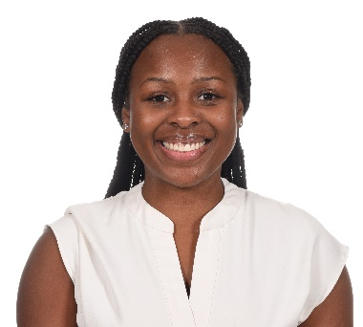
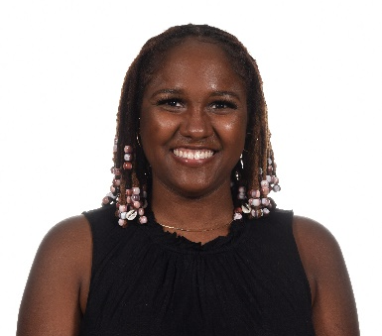
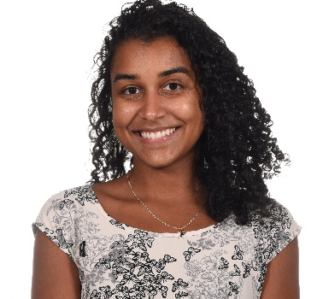
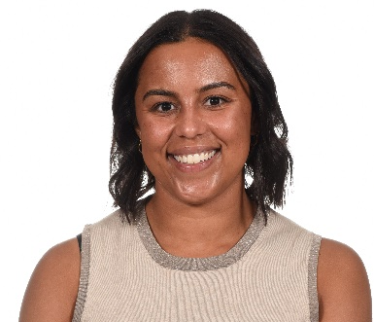
Rikiara Brown M.D. | Carolei Bryan M.D. | Amber Bulna M.D. | Cecilia Di Caprio M.D., M.P.H.
Hometown: Baltimore, MD
Medical School: Howard University
For fun: Self-taught culinary artist. A few of my favorite dishes to cook are oxtail, shrimp scampi, and shrimp tacos. -DJing: mixer of R&B and hip-hop tunes. -I love to photograph nature and use my instant camera to capture moments in time. -I enjoy singing at the top of my lungs at my favorite artists’ concerts. -Collector of passport stamps. I have traveled to Mexico, Jamaica, Bahamas, Aruba, Canada, Dominican Republic, and Colombia. -I love to roller skate. -Professional shower singing.
She/Her
Hometown: Wadesboro, NC
Medical School: University of North Carolina School of Medicine
For Fun: Painting, Listening to Music, Singing, Indulging in Self Care, Skincare, Being a Cat-Mom, Dancing, Netflix, Socializing
Why did you choose Hopkins?:I felt that being at Hopkins would break a glass ceiling I was unaware I had for myself. If I went to Hopkins there would be no limitations to my medical career. During my interview day I felt that they valued my goals and would help me to achieve them throughout and after my residency.
What excites you most about living in Baltimore? I am excited to be in a city where the community largely reflects my appearance and the culture I grew up in.
She/Her
Hometown: Belleville NJ
Medical School: University of Miami
For fun: 1. Singing: I have been part of a cappella groups that allow me to express myself and connect with others through song. 2. Succulents: I nurture a garden consisting of a variety of succulents, including graptosedum, crassula, and aloe. 3. HIIT workouts: Through high-intensity interval training I acquire stress relief and the ability to build my mental strength and push my limits. 4. Anime Enthusiast: I enjoy shonen and shojo genres while learning life lessons and escaping reality.
Why did you choose Hopkins? After my interview day I knew immediately that Hopkins was the home for me. The program placed a lot of emphasis on caring for the community of Baltimore, and I wanted to continue creating substantial change for kids and their families! I have so much opportunity to advocate for my patients. The vibes from program leadership and the residents were on point, and their kindness was palpable even over zoom! I am so happy with my decision, and could not imagine myself anywhere else.
What excites you most about living in Baltimore: There is so much to do in Baltimore! I have been loving the food scene, and it is very easy to get around and meet up with co residents ! I highly recommend trying Clavel as soon as possible!!
She/Her
Hometown: Minneapolis, Minnesota
Medical School: University of Minnesota Medical School
For Fun I: Like to spend time outside (running, hiking, going on walks), cook and hangout with my fiancé, and play board games!
Why did you choose Hopkins? I really really loved my interview day! All the residents I met were incredibly supportive and there was such a strong sense of community among them. I also had a chance to sit in on rounds during the interview, and was really impressed by the level of autonomy that the residents were given and the approachability of the attending. Overall, my goal was to train at a place where I would have the opportunity to care for complex patients in an academic setting while also learning about community pediatrics, social determinants of health, and health equity -- the Harriet Lane Program (and specifically the Health Equity Track) offered me all of this!
What excites you most about living in Baltimore? Being near the water with great walking/running routes, escaping Minnesota winters, and being able to travel easily up and down the East Coast!
She/Her

Slide 5
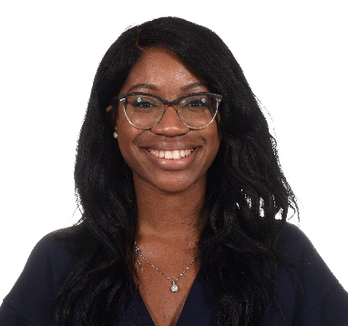
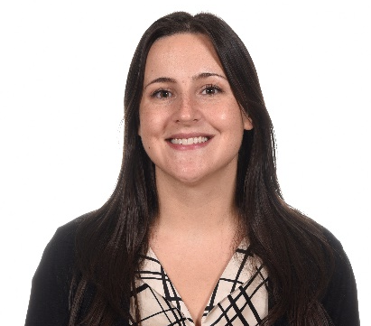
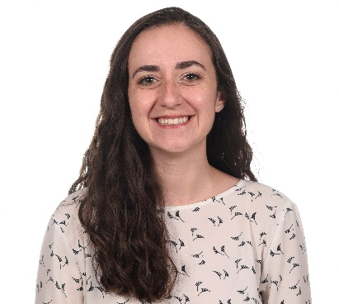
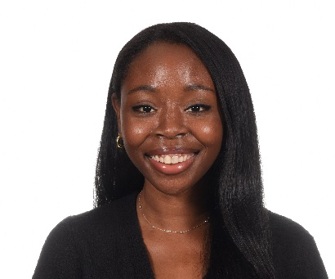
Chizorbam Diribe M.D. | Sarah Ehrenberg M.D. | Rafi Faria M.D. | Whitney Fidelis M.D.
Hometown: Houston, Texas
Medical school: The University of Texas Medical Branch at Galveston
For fun: - Cooking, with interests in recreating meals following different recipes. - Decorating, preferences in modern-style interior designing. - Outdoor activities, such as playing badminton, basketball, and running track. - Playing violin, with interests in learning new instruments, such as the piano.
Why did you choose Hopkins?: I chose Hopkins because I felt so welcomed when I visited for my visiting elective as a fourth year medical student. I really enjoyed the learning opportunities and the people. Everyone not only prioritized providing the best and most comfortable learning environment, but also prioritized wellness and enjoying the journey of residency.
What excites you most about living in Baltimore?: I am most excited about the FOOD. Being from Houston, food is a serious matter. So I can't wait to try all the great, diverse food that Baltimore has to offer! BONUS: Baltimore is very close to different cities in the east coast, so visiting my sister in DC is always quick and easy!
She/Her
Hometown: East Aurora, NY
Medical School: University of Pittsburgh School of Medicine
For Fun: The Buffalo Bills: I'm a massive football fan and every year I'm confident that the Bills will win a Super Bowl (I have yet to be correct). Raising Livestock/Riding Horses: I grew up on a small farm and was an avid participant in the local 4H program where I showed horses, pigs and chickens. I used to compete in barrel racing but now enjoy trail riding when I'm home. Hiking: I love being outdoors and finding ways to be active. I am always looking for new trails, especially ones with waterfalls!
Why did you choose Hopkins? The people! Everyone I talked to throughout the interview process at Hopkins was so kind and seemed genuinely happy to be there. Also, I wanted to go somewhere where I would have the opportunity to work with a diverse population, and knew I would be able to at Hopkins.
What excites you most about living in Baltimore? I love exploring each of the neighborhoods and trying new restaurants with my partner!
She/Her
Hometown: Nova Friburgo, Brazil & Deerfield Beach, Florida
Medical School: University of North Carolina at Chapel Hill
For fun I: garden, cook and eat lots of food, travel, and read!
Why did you choose Hopkins? I wanted to be at a residency program that really values resident education and provides opportunities to be involved in the community and get additional training in health equity! I'm interested in subspecializing and wanted a program that had lots of opportunities to explore subspecialties, while still giving me really good general peds training which Hopkins definitely does. I also loved how happy and close the residents seemed to be, which has definitely been even more true now that I'm here!
What excites me about Baltimore: The food here is amazing!
She/Her
Hometown: Dallas, TX
Medical School: Eastern Virginia Medical School
For fun: Cooking/baking, my hope is to be able to pass down traditional Nigerian recipes to my kids. Still working on mastering them myself though. 2 Curating essential oil mixtures, I create my own natural hair and skin oil mixtures 3 Calligraphy and lettering my favorite song lyrics or quotes 4 Tarheel basketball fan
Why did you choose Hopkins? I chose Hopkins after completing an visiting elective here. Everyone was kind, welcoming and supportive. Creating what felt like a safe learning environment. After a few short weeks I already felt part of something special and continue to feel that way. There is definitely a work hard play hard mentality at this residency program that helps establish great balance.
What excites me about Baltimore: The food! I love seafood (and all food) and it's everywhere here. I take everyone who comes to visit me to eat Maryland blue crabs, would highly recommend. Living close to water has become a non-negotiable for me so I also appreciate being able to take walks with amazing scenery. Lastly appreciate Baltimore's proximity to other fun cities- I have made so many weekend trips to Philly and DC already!
She/Her

Slide 6
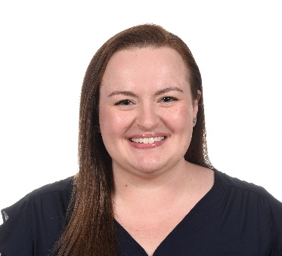
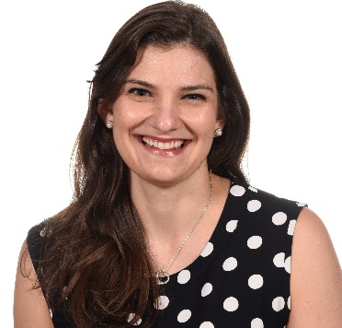
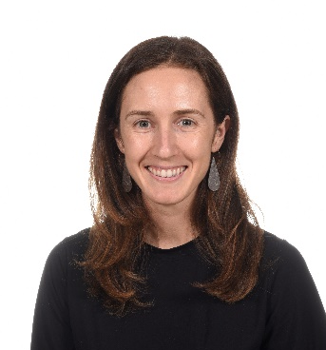
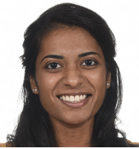
Jeanette Freeman M.D. | Elena Georges M.D. | Rachel Gilbert M.D. | Juliet Joseph M.D.
Hometown: Malverne, NY
Medical School: New York Medical College
For Fun: playing trombone with a group or as a soloist, working with the Alumni Board for the Penn Band, discovering new music and bands, and attending concerts.
Why did you choose Hopkins? I took place in family-centered rounds (virtually!) on my interview day and was blown away at how included everyone was. Residents, attendings, family members, and medical students were all part of the conversation, and it was a very welcoming environment. I was really impressed by the quality of teaching during Noon Conference, and the attendings were excited to teach, too!
What excites you most about living in Baltimore? Living so close to the water! I'm excited to try new restaurants and explore the city with my co-residents. And definitely try more flavors at Bmore Licks.
She/Her
Hometown: Princeton, New Jersey
Medical School: Rutgers Robert Wood Johnson
For fun I: I like to try local restaurants, plan and go on self-created "ice cream tours", read a good book, spend time outdoors, have a laugh with friends/family and catch a good sunrise/sunset! I'm also working on expanding my plant collection!
Why did you choose Hopkins: My interview day! Everyone seemed genuine, warm and clearly passionate about caring for children in the Baltimore area. It was also evident how supportive the program and residents are, and seemed like the Harriet Lane Residency Program truly was a family. I also valued the program's commitment to addressing SDOH. There is also a clear commitment to lifelong learning at Hopkins. Additionally, I really wanted to train at a program that would expose me to bread and butter pediatrics but also complex care patients and "zebras". My list could go on and on!
What excited you most about living in Baltimore: The people- everyone seems genuinely friendly- you can't walk a block or go into a shop without being warmly greeted. There are also so many delicious restaurants (I think I have found every cuisine I could possibly imagine), and I LOVE the waterfront! There is always something going on, whether street festivals, concerts, or races!
She/Her
Hometown: Hobe Sound, FL
Med school: University of Florida College of Medicine
For fun: Guitar, running, surfing, reading, yoga, cooking, and soccer.
Why did I choose Hopkins: As a Neurodevelopmental Disabilities applicant, I was drawn to the robust Pediatric training I would receive at JHH, as well as the incredible range of clinical exposure I would have training at the Kennedy Krieger Institute. I loved how supportive everyone was from program leadership to fellow residents and I feel very lucky to have such wonderful co-residents.
What excites you the most about living in Baltimore: I love how central Baltimore is to many cities up and down the East Coast. I love being outdoors and there is a lot of natural beauty along the harbor and easily accessible parks both in and around the city of Baltimore!
She/Her
Hometown: Greenwood, SC
Medical School: Medical University of South Carolina
For Fun I: like to run, hike up pretty mountains, cook Indian food, travel far and near, and spend time with my family and friends!
Why did you choose Hopkins? I loved the collaborative and teaching environment that Hopkins had to offer. It was easy to see that residents and their growth were prioritized within the program! It was also a major plus having family and friends near the Baltimore area!
What excites you most about living in Baltimore? Being close to family, finding new hikes & running trails, exploring ice cream places, being near lots of fun cities, trying out new water activities
She/Her

Slide 7
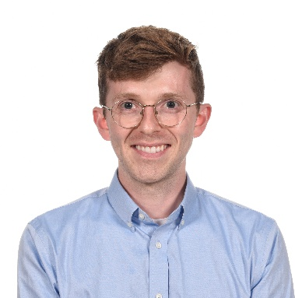
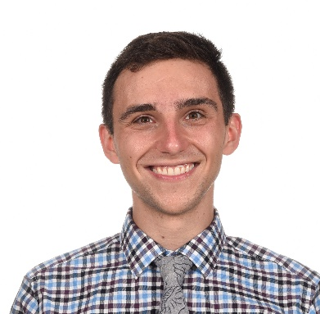
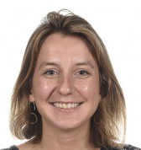
Adam Ketchum M.D. | Andy Koltun M.D. , M.S. | Chiara Pandolfi de Rinaldis M.D., M.P.H.
Hometown: Frederick, MD
Medical School: University of Maryland School of Medicine
For Fun I: enjoy spending time with my 3 year old cat who joined me at the start of my first year of medical school. -I enjoy doing anything outdoors including walking/running around the city, hiking, and fishing with my family
Why did you choose Hopkins? I love the city of Baltimore and all of the opportunities to work at various sites across the city! I really appreciated the emphasis on teaching, particularly for senior residents on inpatient services, as well as the opportunities for research. Also get exposure and training with broad and diverse clinical cases.
What excites you most about living in Baltimore? A beautiful city with a little bit of everything-close to the bay/water, hiking, and amazing food! I spent the last 4 years living in Baltimore and feel like I still have so much to explore and learn about the city!
He/Him
Hometown: Crystal Lake, IL
For Fun I: Writing poetry Perfecting my butter pecan and other ice cream recipes Running along the Potomac Riding, people-watching on, and advocating for the DC Metro
He/Him
Hometown: New York and Boston
Medical School: Perelman School of Medicine
For Fun: Cooking, hiking/backpacking, traveling, strategy board games, pickleball, learning to play ukulele
Why did you choose Hopkins? As couples match applicants, my partner and I felt that few institutions offered the same level of training and opportunity in pediatrics and general surgery. Although the virtual happy hours could be painful, we were also both very excited after our respective sessions in seeing how kind and happy everyone was and how close the residents clearly were. Although we haven't been here long, this gut feeling has not proved us wrong!
What excites you most about living in Baltimore? Although not something I necessarily knew of when choosing programs, some things that I have come to really love about Baltimore are the access to the harbor and green spaces like Patterson Park as well as the wonderful community feel -- there are amazing festivals, farmers markets, and outdoor concerts very regularly. I feel so thankful to call this city my home.
She/Her

Slide 8
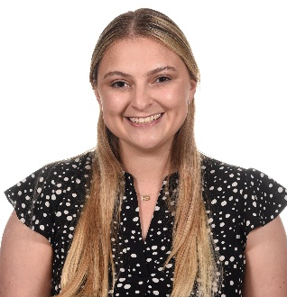
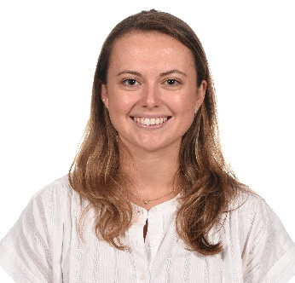
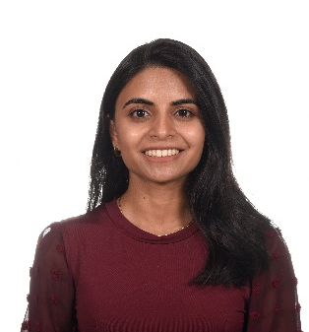
Megan Rescigno M.D. | Harper Robinson M.D. | Sarika Sachdeva M.D.
Hometown: Reno, Nevada
Medical School: University of Nevada, Reno School of Medicine
For Fun I: go for walks around Fells Point and Canton, try new restaurants in the area, and spend time with my amazing cointerns!
Why did you choose Hopkins? I chose Hopkins for the endless opportunities that are available to residents. The teaching we receive from faculty is phenomenal and I am continually astounded by the opportunities available to learn from national leaders within pediatrics. Being far from home, it was really important to me to find a place where I felt supported by both residency leadership and peers. Since starting intern year, I have constantly found myself surrounded by hard working, smart, and most of all FUN people who want nothing more than for each other to succeed. This is an environment that I knew I could thrive in. For these reasons along with many more, I am so glad I chose Hopkins!
What excites you most about living in Baltimore? I love waking up every morning to see the Inner Harbor and going on runs in Fells Point. There are so many great restaurants and bars in the area. Of note, I am a huge fan of bmore licks (ice cream)! It is also very nice to be only a short train ride away from DC!
She/Her
Hometown: Greenwich, CT
Medical School: NYU Long Island
For Fun I: enjoy being active, especially outdoors. Some of my favorite activities are hiking, surfing, and distance running
Why did you choose Hopkins? I chose Hopkins because on interview day it was clear that the residents, faculty, and leadership were fun, down to earth, and cared about learning. I love the focus on residents as teachers and the graduated autonomy here. Since starting intern year, every single resident and faculty member has been so kind and supportive, and it has been such a wonderful learning environment! Also, the complexity and variety of cases that you see here is pretty amazing.
What excites you most about living in Baltimore? I love being close to the water and running or walking along the harbor! There are so many great restaurants in Baltimore and I’m so excited to try more of them. Everything is very accessible, and I love being able to walk or bike to work and to see friends.
She/Her
Hometown: Johns Creek, GA
Medical School: Duke University
For Fun: Houseplants: Currently caring for my collection of 30+ plants while plant-sitting for friends on their away rotations. Container gardening: My largest cherry tomato plant is taller than I am! I’m planning to expand my harvest to beans and carrots next year. Dance: I was on a competitive travel team while at Emory and performed in the 2015 Macy’s Thanksgiving Day Parade. Green Bay Packers fan: I was born in Wisconsin and am an avid Packers fan. Hoping for another Super Bowl win!
She/Her

Slide 9
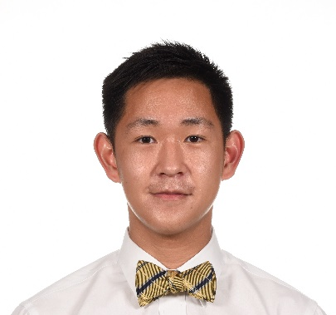
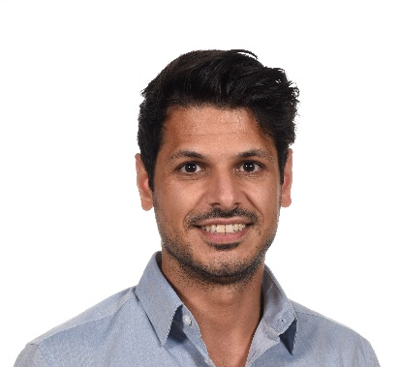
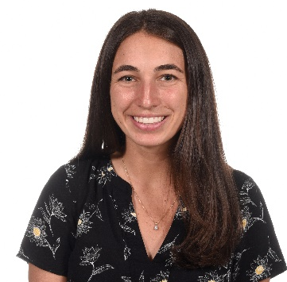
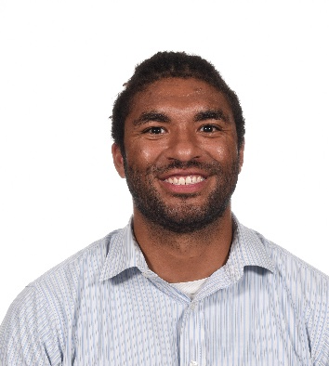
Vincent Shieh M.D. | Rohan Soman M.D., P.hD | Anthony Spellman M.D. M.S. | Melissa Trofa M.D.
Hometown: New York City, NY
Medical School: Trinity School of Medicine
For Fun I: Activities/Sports: Chess (Elo 1901) and other board games, Number and Word Puzzles, Fencing (Foil), Basketball Arts: Classical Violin, Classical Piano, Music Composition, Photography
Why did you choose Hopkins? Hopkins is filled with fantastic clinical mentors. While they are leading experts in their respective fields, they love to teach and readily take time to precept everyone who wants to learn. There are also endless opportunities beyond the clinic to be involved in scholarly activities such as basic science research and global health.
What excites you most about living in Baltimore? Capturing the cityscape of Downtown Baltimore and surrounding areas with my camera
He/Him
Hometown: Cincinnati, OH
Medical School: Cornell
For Fun: Capoeira: Train and perform capoeira, a Brazilian cultural and martial art, with Carioca Capoeira, graduated rank Laranja-Azul in 2018. Performances in city sponsored cultural events in NYC, Miami, Baltimore, and Columbus, and work with child and adult classes.
He/Him
Hometown: Mclean, VA
Medical School: Wright State Boonshoft School of Medicine
For Fun: Snowboarding - Instructor/Enthusiast Surfing Lacrosse - Coach/Player Video games- League of Legends - Team Captain Music- I play the drums and saxophone
Why did you choose Hopkins?: The initial excitement from receiving my interview and the warm fuzzies I continued to experience on interview day immediately solidified my decision to choose Hopkins. I wanted to complete residency at a program would challenge and support me. I could feel the residents connection to one another, genuine like for each other, and appreciated the transparency they provided regarding positives and negatives of the program. They felt heard from faculty and administration which was important to me. I wanted an environment which focused on collaboration vs competition and fostered professional and personal growth. All boxes Hopkins checked for me. Plus I love bluejays and lacrosse :)
What excites you most about living in Baltimore? Crabs, crabs, crabs, crabs, crabs, crab everything its great. Old bae is life. Love being by the water, the harbor is extremely relaxing. The cultural diversity in this city is unmatched. I've enjoyed brunching with co-interns, hiking in the suburbs, and integrating into the community.
He/Him
Hometown: Clarendon Hills, IL
Medical School: Sidney Kimmel Medical College at Thomas Jefferson University
For Fun I: For fun I play soccer, bake and hang out with my coresidents!
Why did you choose Hopkins?: I loved my interview day! Everyone was so friendly, and I loved that Hopkins has a close-knit community. The emphasis on teaching was also something that drew me to Hopkins. I'm so excited to be training at one of the best institutions!
What excites you most about living in Baltimore? I'm excited to explore the food scene! I've also enjoyed walking around the inner harbor - it's super pretty at sunset.
She/Her

Slide 10
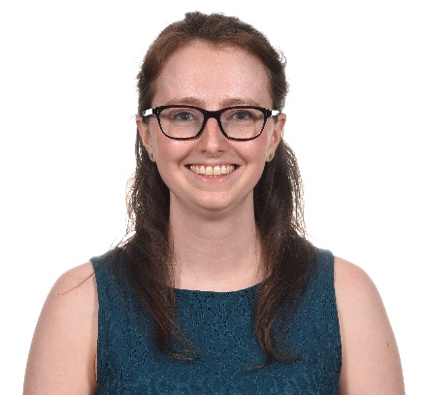
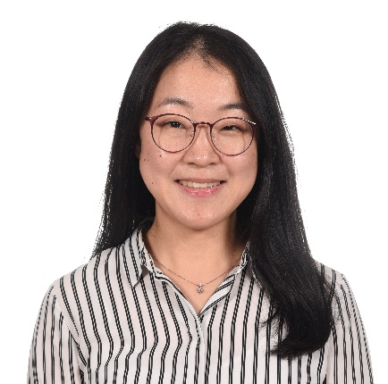
Sarah Vogel M.D. | Priscilla Yong M.D.
Hometown: Columbia, MD
Medical School: University of Maryland School of Medicine
For Fun: From a young age I have loved musical theatre and the performing arts. In addition to seeing shows whenever I can, I joined my school’s acapella group, learned to play the ukulele, and took local classes in aerial acrobatics.
Why did you choose Hopkins? I am a Child Neurology resident and I chose Hopkins after doing an away rotation here and getting to know all of the incredible faculty that we get to work with. I also am looking forward to all of the opportunities to be involved in public health and patient advocacy for the Baltimore community.
What excites you most about living in Baltimore? I've lived in or around Baltimore for a long time, but I'm excited to share some of my favorite spots with all of the new interns moving to Baltimore. I'm also excited to learn of new places I haven't been before!
She/Her
Hometown: Gig Harbor, WA
Medical School: Renaissance School of Medicine at Stony Brook University
For fun I: knit/crochet, bake muffins/scones, go out on walks.
Why did you choose Hopkins? The strong emphasis on teaching and education really stood out to me on interview day and the residents seemed genuine and down-to-earth. After 1 month of being here, I can confirm that the impressions I received on interview day are true. Every day I am inspired by the incredibly supportive, kind, and intelligent people who care about the patients, appreciate each other and are excited to learn and grow.
What excites you most living in Baltimore: I've always lived in small towns, so I am excited to explore the breadth and depth of food and culture a city could offer while not being completely overwhelmed by the traffic and busyness of a large city.
She/Her

Slide 11
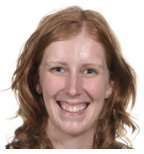
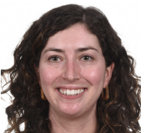
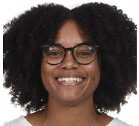
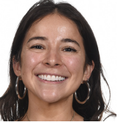
Danielle Amundsen M.D. | Dana Goplerud M.D., M.P.H. | Adrienne Johnson M.D. | Raquel Sofia Sandoval M.D., M.P.P.
3rd Year Med-Peds Residents!
Hometown: Waunakee, WI
Medical School: Johns Hopkins
For Fun I: spend time in Patterson Park with my dog (Nemo) and partner (Jason), go backpacking and hiking, make pottery, and go swimming!
Why did you choose Hopkins? As a medical student here, I loved the patients and families I got to work with. I loved the multidisciplinary, family-centered approach to care and the opportunities for advocacy and community-based care.
What excites you most about living in Baltimore? Exploring different Baltimore neighborhoods is one of my favorite activities. Each neighborhood is so unique, and people are very proud of where they are from. My partner works for the Baltimore City Recs and Parks (not Parks and Rec!) Department, and we love spending time in Patterson Park near our home (with many stops at B'more Licks for ice cream) and visiting other parks across the city.
She/Her
Hometown: Tampa, FL
Medical School: Johns Hopkins
For Fun I: I like to bake elaborate desserts, salsa dance, and go for walks along the harbor!
Why did you choose Hopkins? I chose Hopkins for the strength of clinical training, patient diversity, and commitment to education.
What excites you most about living in Baltimore? walks along the harbor, quirky neighborhoods, great sunsets
She/Her
Hometown: Middletown, DE
Medical School: Sidney Kimmel Medical College (Jefferson)
For Fun: Sports. Pickleball, Hiking/Camping
Why did you choose Hopkins? I chose Hopkins because the Med-Peds program values aligned so closely with my own. I wanted a program that valued serving the an urban population while continually looking for ways to improve the health and wellness of that community even if that means redesigning the system meant to provide those things. I also wanted a program that saw and valued me as a person and I’ve felt that not only with my class on both categorical sides, but the faculty and leadership as well. Finally, I chose Hopkins because Baltimore is an amazing city and I fell in love with it during my time here during undergrad! I went to Hopkins and played varsity soccer so I’m very excited to be a Blue Jay once again!!
What excites you most about living in Baltimore? Baltimore has great food and fun within and surrounding the city. I’m really excited to get to explore more of the hidden gems on my days off!! When I ask for recommendations on what to explore, I get new suggestions every time.
She/Her
Hometown: Cali, Colombia
Medical School: Harvard Medical School
For Fun I: Gardening, pottery, painting, biking, hiking, dancing, reading (nonfiction, personal essays, poetry), podcast-ing, pop-culture enthusiast, trying new restaurants, and traveling.
Why did you choose Hopkins?: I want to be a primary care doctor and the urban health med/peds program is a dream to help me fulfill my dream :)
What excites you most about living in Baltimore? Being in a city with lots of small neighborhoods with lots of local businesses to check out and support.
She/Her

Slide 12
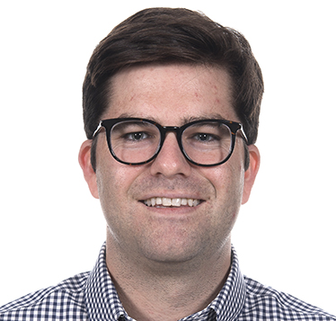
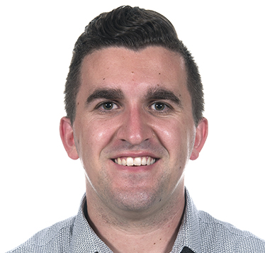
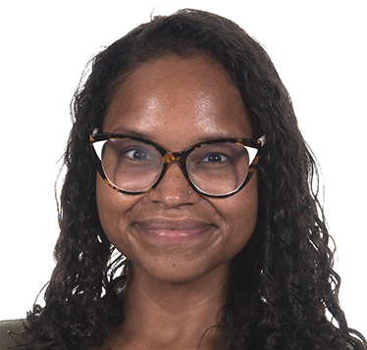
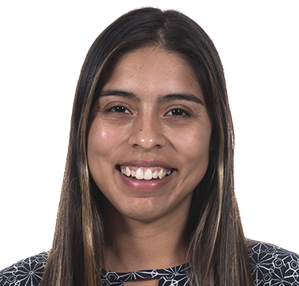
Edward Corty M.D., M.P.H. | Ross Gilbert M.D. | Vianca Masucci M.D. | Andrea Silvas M.D.
4th Year Med-Peds Residents!
Hometown: St. Petersburg, FL
Medical School: Florida State University
For Fun I: Read the Harriet Lane Handbook. But seriously, I enjoy jogging, taking my dog, Annie to Patterson Park, and trying new coffee shops.
Why did you choose Hopkins? Location was important to me and my fiance, Courtnee and we LOVE Baltimore. In addition, I have always found the Hopkins community to be forward thinking yet humble. I wanted to be in an environment where it was encouraged to say "I don't know" because the patient's well-being is prioritized far above pride. I have found this to be repeatedly true at Hopkins.
What excites you most about living in Baltimore? From Fell's Point to Hampden to Highlandtown, every Baltimore neighborhood has a different feel. A common thread, however, is that everyone says hello (it really is Charm City). I love being out in the city and trying the new restaurants that are always popping up. In addition, I feel immensely privileged to work in partnership with individuals and communities in Baltimore towards improved health and well being.
He/Him
Hometown: Howards Grove, WI
Medical School: University of Wisconsin
For Fun I:
Go for walks to Patterson Park and BMore Licks with my wife, daughter, and dog.
Why did you choose Hopkins?
I was so impressed by the Med-Peds program's commitment to urban underserved primary care and urban health leadership. Plus everybody I met on interview day (from IM to Med-Peds to Peds) was absolutely incredible!
What excites you most about living in Baltimore? Top 3 reasons, in no particular order: (1) Baltimore is so walkable with countless great restaurants abound. (2) Mr. Trash is an icon.(3) My daughter has a set of grandparents just 2.5 hours away!
He/Him
Hometown: Newark, NJ
Medical School: Penn State
For Fun I: Weight lifting; attending live theatrical performances; acting; writing poetry; dog training; travel; finding everyday adventures; cooking
She/Her
Hometown: El Paso, TX
Medical School: Texas Tech
For Fun I: Do lots of yoga (especially like practicing handstands), learn dance choreographies on TMilly TV or Youtube and share them videos on IG (or just record myself and never share them), take dogs on walks (mostly just Molly because Pico doesn't listen), and help my husband create guitar videos (although the majority of the time I just watch him rock out).
Why did you choose Hopkins?: I chose Hopkins because of the Urban Health Primary Care focus the Med/Peds program has. I knew it would best prepare me to one day return to my hometown and influence/improve the primary care scene there. The program also seemed incredibly family friendly and mega sensitive to resident wellbeing, all things which I desired. However, I ultimately came here because I had met Dr. Lenny Feldman and Dr. Angela Orozco before interview season formally started and I just knew I wanted them to be my bosses.
What excites you most about living in Baltimore? Being surrounded by water! As someone who has lived the majority of my life in a desert, I have already loved quick beach/river getaways and running by the harbor.
She/Her

Slide 13
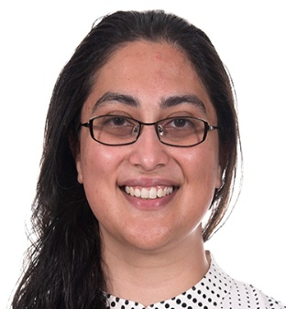
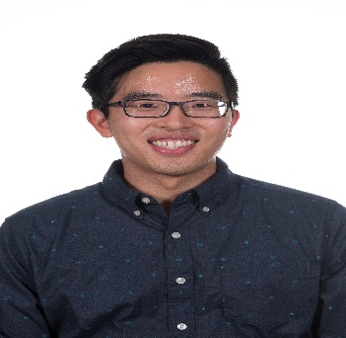
Saher Ali M.D., M.S. | Matthew Kosasih M.D.
4thYear Peds- Anesthesia Residents
Hometown: Latham, MD
Medical School: Penn State
For Fun I: Gardening/taking care of my fruit trees, cooking, volleyball and tennis, taking naps (especially in my hammock!)
Why did I choose Hopkins: Combined pediatrics-anesthesiology program, friendly and down-to-earth people, being close to my family, and the opportunities to make advocacy and service part of my training
What excites me most about Baltimore: Food scene, being by the water. Being in the DMV overall - culture, community, close to everything
She/Her
Hometown: Milwaukee, WI
Medical School: Medical College of Wisconsin
For Fun I: I love to eat out as much as I can, drink bubble tea every waking moment, and hang out with my lovely wife and two "daughters" (they're cats). Why did you choose Hopkins? Program and faculty are incredibly supportive with a superior focus on teaching and resident autonomy. Residents are kind, admirable, and down to earth.
What excites you most about living in Baltimore? THE FOOD!!!!
He/Him

Slide 14
Sapna Desai M.D. | Alex Jaksic M.D.
5thYear Peds- Anesthesia Residents
Hometown: Wellesley MA
Medical School: Zucker School of Medicine and Hofstra/Northwell
For Fun I: I enjoy walking to new places, working out, peanut butter, and cooking. Big fan of dogs. I picked up drawing with charcoal in undergrad at Union College, it has been a mix of a relaxing (sometimes a novel source of stress).
Why did you choose Hopkins? I am in the Combined Pediatrics-Anesthesiology Residency Track, and the established culture of cooperative/interdisciplinary training at Hopkins allowed me to pursue my interest in pediatrics as well as anesthesia in parallel.
What excites you most about living in Baltimore? I am living in the inner harbor area and have found it to be a very lively and fun area to explore. Since arriving I started hiking in some of the surrounding areas. I have only great things about the food scene here and once restaurants open up again, I am looking forward to trying places out!
He/Him
Hometown: Melbourne, Florida
Medical School: University of Central Florida
For fun I: Hangout with friends, play board games, rock climb, travel
Why did you choose Hopkins? The leadership truly supports the residents, everyone is happy, good work life balance
What excites you most about living in Baltimore: The crab and charm of all the different neighborhoods
She/Her

