Slide 1
PGY-2 Class 2024-2025

Slide 2
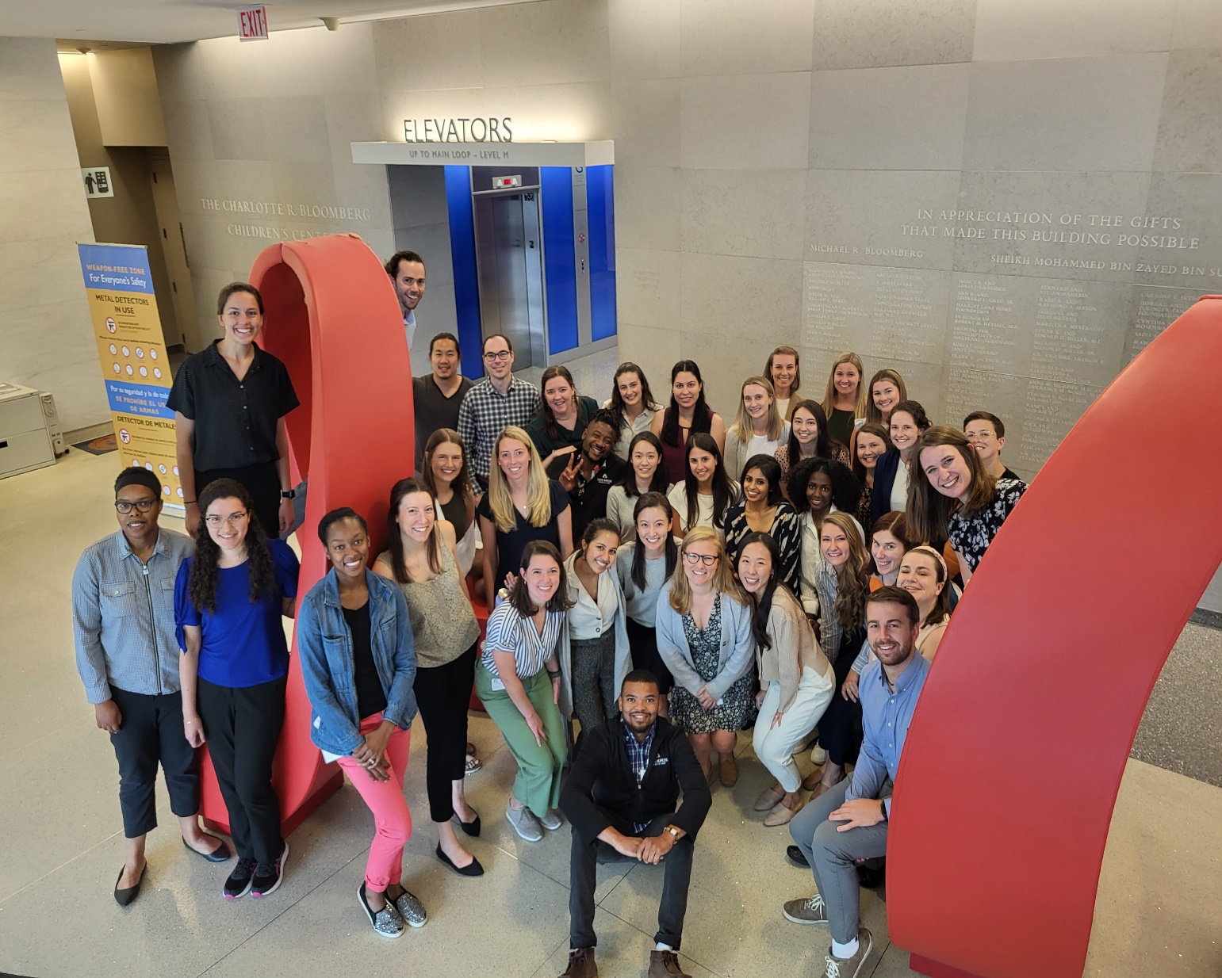
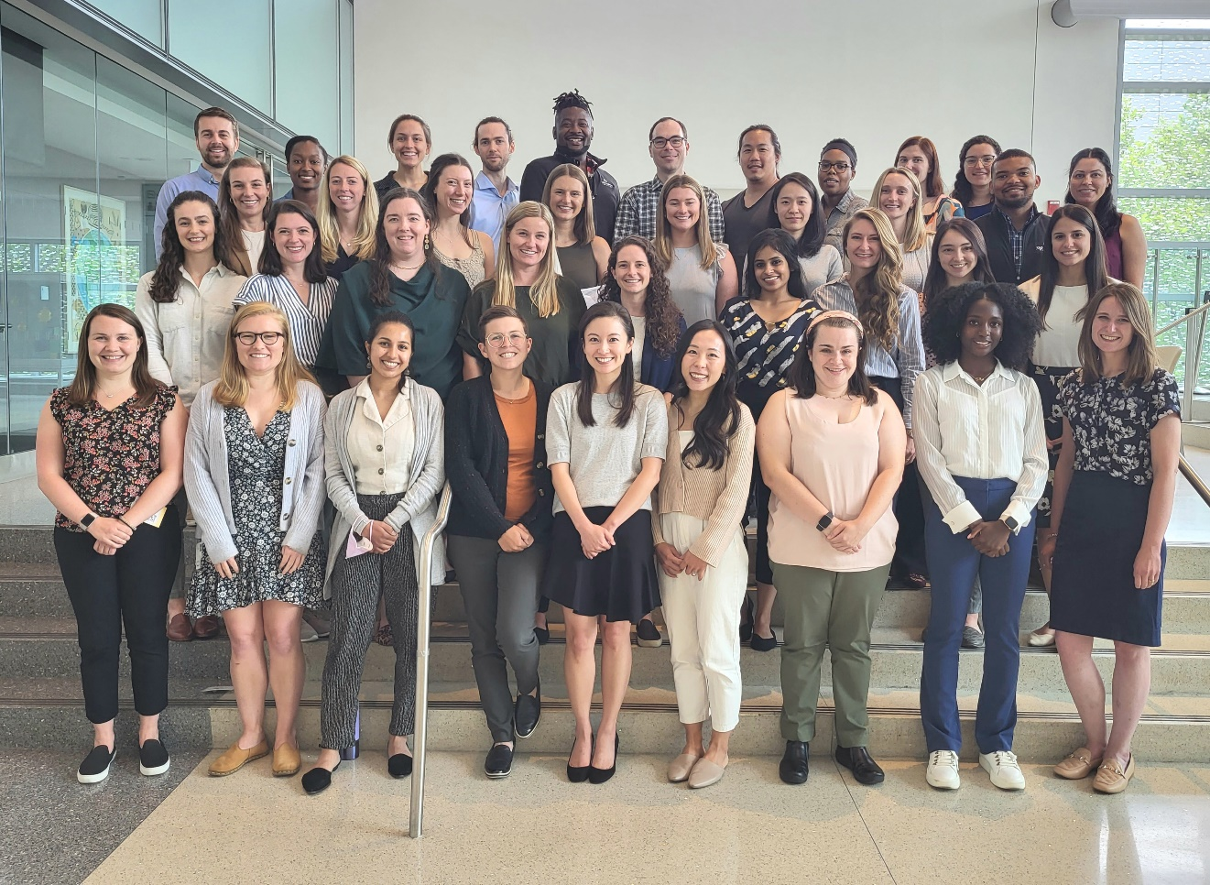

Slide 3
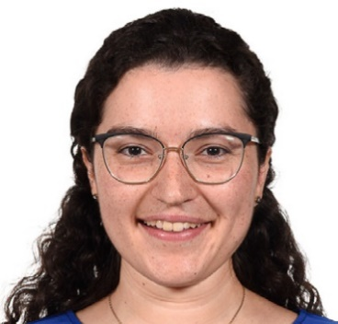
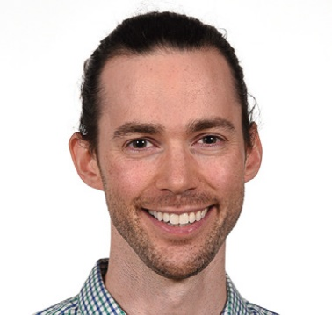
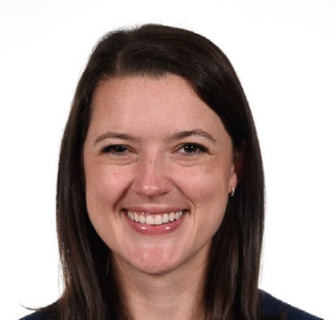
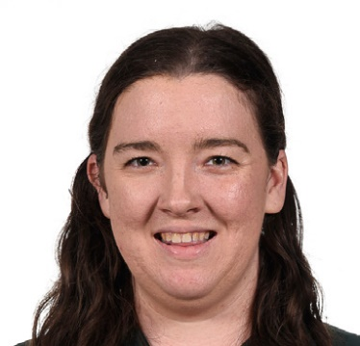
Christine Atik M.D. | Alan Blayney M.D., Ph.D. | Gillean Connolly M.D., M.P.H. | Sarah Crawford M.D.
Hometown: Tulsa, OK
Medical School: Johns Hopkins University School of Medicine
For Fun I: I love to paint, bake, run, garden, swim, and travel!
Why did you choose Hopkins: I loved my experiences at Hopkins both as a previous medical and undergraduate student! The people, wonderful community, and collaborative environment, filled with so many exciting opportunities, make Hopkins so special.
What excites you most about living in Baltimore: Having spent the past eight years here, Baltimore has become my second home! I love exploring the different neighborhoods, each with its own unique character. You can often find me walking around the Inner Harbor, visiting the National Aquarium, Federal Hill, the Walters Art Museum, or Peabody Library!
She/Her
Hometown: Ottawa, Canada
Medical School: SUNY Upstate
For Fun I: I spend every spare moment with my small (for now) children. If I'm awake before they're up, I'm probably crafting espressos. If I'm awake after they sleep, I'm probably cleaning up after an overly complex work-night dinner.
Why did you choose Hopkins: Hopkins is one of the few major academic hospitals in a major metro area that my family and I can actually afford to live near! The integration of the PICU and anesthesia services in the same department, and the clear focus on teaching, learning and leadership in both the pediatrics and anesthesia residencies make this an ideal training environment for me.
What excites you most about living in Baltimore? Patterson Park is my new back yard. There are a plethora of great restaurants and local coffee roasters. I can have a house with a spare room here. As a migrant from a family of migrants, the many Baltimore-DC airports are a boon.
He/Him
Hometown: Austin, TX
Medical School: Baylor College of Medicine For Fun: I love spending time outdoors! I enjoy running in Patterson Park, walking along the harbor, and hiking with my husband. I also find joy in cooking and exploring the Baltimore restaurant scene.
Why did you choose Hopkins: Hopkins offered me the opportunity to explore a wide range of pediatric subspecialty care while also working with a diverse and underserved patient population. I loved the people I met on my interview day and could sense a strong community among the residents. No matter what field I choose within pediatrics, I feel confident Hopkins will prepare me well for my future career!
What excites you most about living in Baltimore: I'm excited to explore many of the nearby outdoor trails and state parks in the surrounding area!
She/Her
Hometown: Pensacola, FL
Medical School: Florida State University
For Fun: Roaming the aisles of Target, True Crime Podcasts, finding new running routes in the Baltimore area, eating good food (especially ice cream)
Why did you choose Hopkins: I am interested in medical education and training, and I fell in love with Hopkins during my interview day after learning about the opportunities to become a great teacher and learner. I am also excited to be at a program that balances treating the sickest patients while also advocating and caring for pediatric patients in our Baltimore community.
What excites you most about living in Baltimore: The food and living close to the water! I have loved getting to know my co-resident family and can't wait to work my way through all of the soft serve flavors at Bmore Licks!!
She/Her

Slide 4
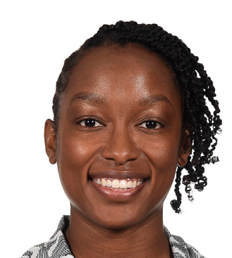
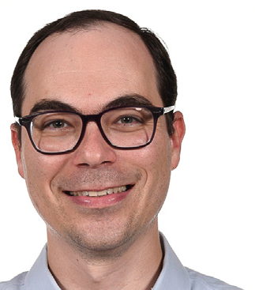
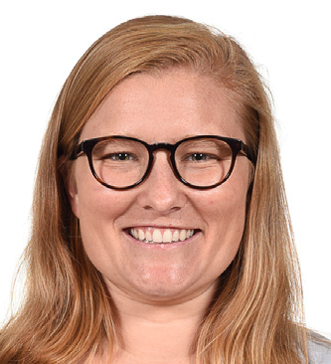
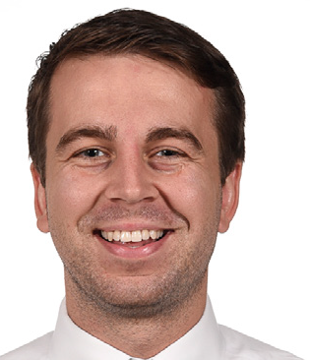
Courtney Edwards M.D., Ph.D. | Brian Extein M.D., J.D. | Charlotte Gemes M.D. | Sean Greiner M.D.
Hometown: Greensboro, NC
Medical School: Vanderbilt University
For fun I: Dance, try new foods, travel, go running with my dog
Why did you choose Hopkins?: I attended the URiM Second Look Weekend after interview season and was completely sold after my visit. I had a wonderful and necessary opportunity to meet with a diverse group of faculty mentors who looked like me and had similar life experiences as me. This really helped me to envision what my own career trajectory could be if I trained at Hopkins. In general, I just appreciated seeing so much diversity amongst the Hopkins residents, faculty and staff. I felt like I could not only fit in, but also belong.
What excites you most about living in Baltimore? After living in a landlocked state for almost 8 years, I am so excited to be back on the coast. I feel happiest when I am by the water and am looking forward to the fresh seafood!
She/Her
Hometown: Baltimore, MD
Medical School: University of Maryland School of Medicine
For Fun I: Love to spend time with my family, hike on some of the many great trails around Baltimore, and try out new restaurants
Why did you choose Hopkins?:I was drawn to the incredible faculty at Hopkins, the outstanding training in both pediatrics and psychiatry, and the exciting combined program in Child and Adolescent Psychiatry
What excites you most about living in Baltimore? Baltimore is a great place to live with wonderful parks, trails, restaurants, and museums!
He/Him
Hometown: Bronxville, NY
Medical School: University of Vermont
For fun I: Like being outdoors, exploring the city, listening to podcasts, going to concerts, and paddleboarding!
Why did you choose Hopkins? I was looking for a medium sized program that still had high acuity and a wide range of pathology. Hopkins definitely met that criteria! The global health opportunities and partnerships around the world were also a major draw for me. Additionally, the people are all so compassionate and brilliant!
What excites you most about living in Baltimore: I am excited to explore all of the different neighborhoods and to be living near the harbor.
She/Her
Hometown: Bluffton, SC
Medical School: Medical University of South Carolina (MUSC)
For Fun I: like to play tennis, go for a jog around Fells Point, try new restaurants and bars, or go hiking.
Why did you choose Hopkins? Hopkins has so much to offer between excellent clinical experience, a focus on resident education, opportunities for research, and great relationships between faculty and residents. I wanted to learn pediatrics at an institution where I could both serve the local population to learn effective primary care and have patients referred to learn in-depth specialty care. Hopkins fit both of those goals - and my interview day was such a positive experience where I knew that I would be able to learn and explore my interests here!
What excites you most about living in Baltimore? Growing up in South Carolina, I am enjoying living in a larger city and all it has to offer - including major sports teams, good food, and lots to explore. Living a block from the waterfront doesn't hurt either!
He/Him

Slide 5
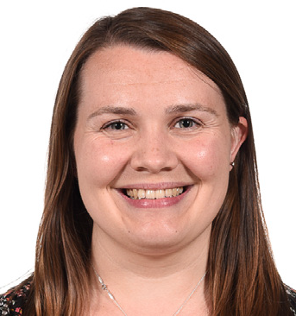
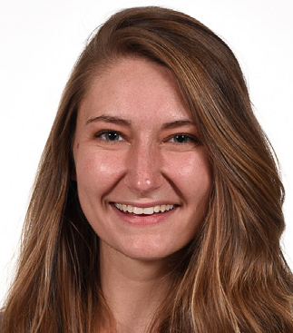
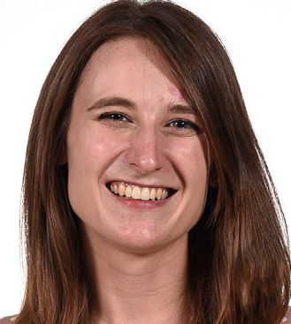
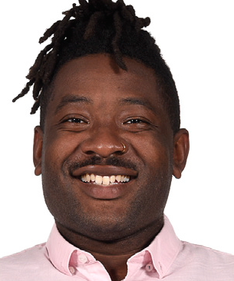
Lizzie Herman M.D. | Casey Hribar M.D., MBA | Erin Jarvis M.D. | Darius Johnson M.D.
Hometown: Yardley, PA
Medical school: Columbia University
For fun I: enjoy spending as much time outside as possible! Catch me baking, hiking, watching the USWNT, walking (sometimes attempting running) along the water, and trying to teach my cat how to swim.
Why did you choose Hopkins?: I loved the community and culture of both the residency program and the area that we serve.
What excites you most about living in Baltimore?: I'm so excited to try new restaurants and love to be living so close to the water. Besides learning how to become a pediatrician, I am also thrilled to learn how to eat a crab and root for more bird themed sports teams (still an Eagles fan though).
She/Her
Hometown: Hilliard, OH
Medical School: University of North Carolina at Chapel Hill
For Fun: Explore new Baltimore restaurants and hotspots, go see live music any chance I get, hang out with my two dogs, sing, and relax with a good book!
Why did you choose Hopkins? I know several people currently training across the institution or who were alumni that spoke SO highly of Hopkins and its people! I also think there's something for everyone/every interest here and the resources are excellent.
What excites you most about living in Baltimore? Baltimore is a vibrant city with lots of opportunities and experiences. There's so much to check out! I also live in the suburbs and love that I can have that pace of life, too!
She/Her
Hometown: Garnet Valley, PA
Medical School: Lewis Katz School of Medicine at Temple University
For fun I: I enjoy spending time outside, discovering new cafés and restaurants in town, and attending concerts. I also love to travel and explore new parts of the world, with favorite places including French Canada, Acadia National Park, and Morocco.
Why did you choose Hopkins? As a Neurodevelopmental Disabilities candidate, I chose Hopkins for its unparalleled learning opportunities at Kennedy Krieger. I also admire the passion my colleagues share for health equity, including their devotion to improve community health and advocate for disability rights.
What excites me about Baltimore: I love watching the beautiful Baltimore sunsets from my rooftop deck, and I look forward to enjoying many more!
She/Her
Hometown: Baltimore, MD
Medical School: Johns Hopkins University School of Medicine
For fun: Do hobbyist photography, listen to true crime podcasts or read forensics books Why did you choose Hopkins? I loved my pediatric sub-I when I was a medical student here. The residents and attendings alike seemed excited to teach and I could always find a role model amongst them. The general dedication to caring for patients in Baltimore was refreshing to me as a Baltimore native and made me want to be a part of the peds community here. What excites me about Baltimore: The food and the outdoor space!
They/Them

Slide 6
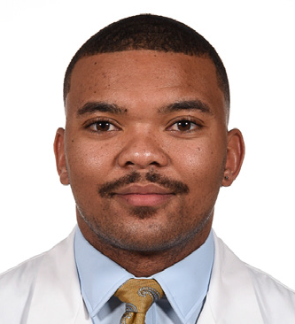
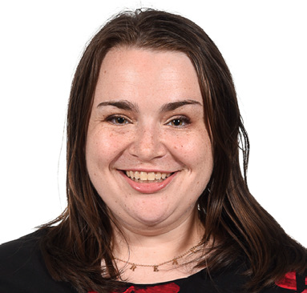
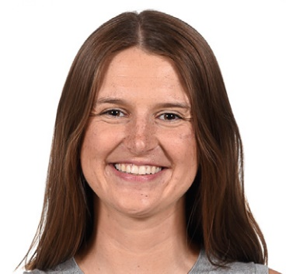
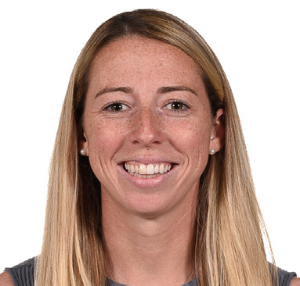
Jaz-munn Johnson M.D. | Sarah Kelleher M.D. | Molly Kuehn M.D. | Ellie McNulty M.D., M.H.S
Hometown: Newport News, VA
Medical School: Virginia Commonwealth University
For Fun: Play Basketball, work out, Love Ping pong, Church, Reading, Beach (it's a verb), playing some chess, going to the movies solo dolo (one of my favorite things to do)
Why did you choose Hopkins? Hopkins has always been a dream of mine, since I was a kid I dreamed of coming here. Of course you have the history and the legacy - but the thing that really blew me away was the faculty. It's hard to explain but I really felt seen, and wanted. This all started when I called one of the APDs to notify them of my inability to participate in the virtual visiting elective because of scheduling conflicts - without even seeing my full application I was offered an in-person away rotation. I was blown away by that!! I ultimately declined because I felt I didn't have the bandwidth but it spoke volumes to how serious they were about recruiting URiM students, which means a lot as an African-American male. This coupled with an incredible interview experience, great resident socials and the world-class training (as a resident and within the Health equity track), made Johns Hopkins the right choice for me!
What excites you most about living in Baltimore? Just being in a new place. I was in Richmond for a while so I'm excited for a fresh start. I love being close to the water and so many major cities as well (New York, Philly, DC). And of course... the food scene!!! Ya boy loves to eat lol
He/Him
Hometown: Cupertino, CA/ Ferndale, WA/ Basingstoke, England
Medical School: LSU New Orleans
For fun I: Love to do karaoke and figure skating
Why did you choose Hopkins: I am excited to learn and grow in such an innovative environment and help the children and families of the greater Baltimore area
What excited you most about living in Baltimore: The food! And being so close to other fun cities.
She/Her
Hometown: Coralville, IA
Med school: Duke University School of Medicine
For fun: Garden, read, make photo books, watch sports, and spend time outdoors, especially near water
Why did I choose Hopkins: A couple reasons I chose Hopkins are the strength of clinical training and the opportunities for community partnership and advocacy through the Health Equity track
What excites you the most about living in Baltimore: Being near the water, frequent walks to get ice cream, and the many festivals and community events
She/Her
Hometown: Annapolis, MD
Medical School: Penn State College of Medicine
For Fun I: I like to spend time outside and enjoy running, playing lacrosse and pickleball, boating, and going to the beach.
Why did you choose Hopkins? On my interview day, I loved the supportive and team-oriented culture among the residents and faculty. I wanted to be a part of a program that both challenged me and inspired me to become the best version of myself. Through talking with the residents and previous Harriet Lane alums, it was clear how much they felt being a part of this residency program positively impacted their careers in pediatrics. I am also thankful to be close to family. What excites you most about living in Baltimore? I am excited to explore all that there is to do in Baltimore. I have enjoyed being so close to the water and finding great restaurants.
She/Her

Slide 7
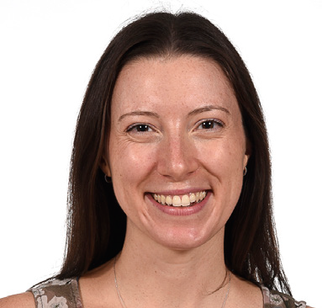
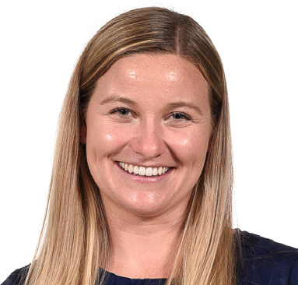
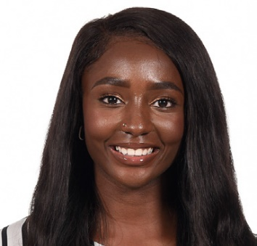
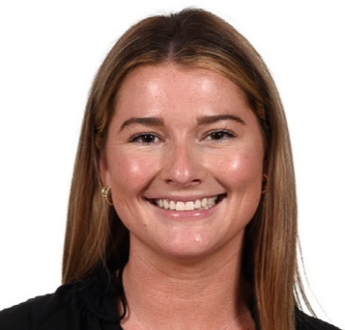
Lucy Murnane M.D. | Jenna Neumaier M.D. | Dilys Osei M.D. | Susannah Pitt M.D.
Hometown: West Chester, PA
Medical School: Geisinger Commonwealth School of Medicine
For Fun I: Peloton, run, do crossword puzzles & play board games, listen to music, try new restaurants!
Why did you choose Hopkins? I loved my interview day! Every person I spoke to was incredibly welcoming. It was clear that each resident and attending were so passionate about their different clinical and research interests. At Hopkins, I get to train at a world renowned institution while caring and advocating for the children of Baltimore. Plus, I'm a quick drive away from my hometown!
What excites you most about living in Baltimore? Living on the water! Crab! Meeting new friends!
She/Her
Hometown: Garrett Park, MD
Medical School: University of Maryland School of Medicine For Fun I: Cook (hit me up for vegetarian recipes!), hike, practice yoga, read novels, and explore Baltimore’s incredible restaurant/brewery scene Why did you choose Hopkins? I went to medical school in Baltimore and didn’t want to leave!! I loved Hopkins’ dual commitment to both advocacy and community involvement, as well as its cutting-edge research. I also felt confident I would get exceptional primary care training (including in taking care of adolescents!) at the Harriet Lane Clinic. When it came time to make a rank list, I had a strong a gut feeling that this was a program where I could feel supported, grow as a learner and a critical thinker, and ultimately thrive. What excites you most about living in Baltimore? EVERYTHING. Well, specifically, I love the vibrance of the city’s communities, its proximity to water (and to my family), and the phenomenal food scene. Special plug for the Hampden neighborhood, which has been described as the “Brooklyn of Baltimore”- it is a very special community with lots of green space, quirky antique shops, and a thriving LGBTQ scene.
She/Her
Hometown: Buffalo, NY
Medical School: University of Buffalo
For Fun I: I am a big Buffalo Bills fan, I also enjoy playing some sort of organized sport (most recent was kickball), any sort of water activity, traveling, snowboarding, and spending time with co-residents.
Why did you choose Hopkins: I loved all of the people I met during my interviews and how supportive the environment was. I also wanted to go to a program that I had the opportunity to explore different areas of pediatrics and neurology with great mentors!
What excites you most about living in Baltimore? Living near the ocean, trying out fun restaurants, spending time in Patterson Park, and living somewhere that doesn't get dumped on with snow.
She/Her
Hometown: Monroe, GA & Manchester, CT
Medical School: Medical College of Georgia
For Fun: Enjoy spending time with my family and friends, weightlifting and anything fitness-related, traveling to new places, and binge-watching new shows.
Why did you choose Hopkins? I chose Hopkins for the opportunity to care for underserved patients and receive expertise training in global health. I also did an visiting rotation here during my fourth year of medical school and was instantly sold by how kind and genuine everyone was from the attending to resident level!
What excites you most about living in Baltimore? I am most excited to live in a culturally diverse city with never-ending opportunities to explore, enjoy amazing food, and try new things.
She/Her

Slide 8
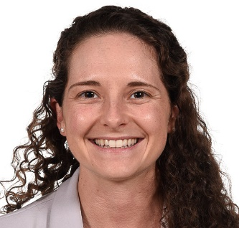
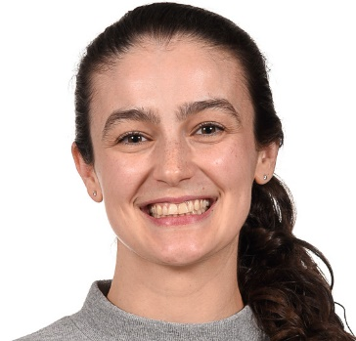
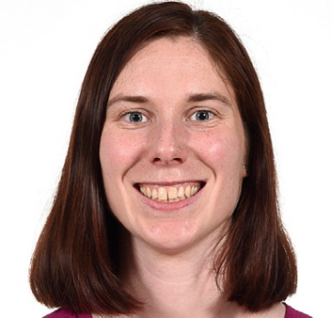
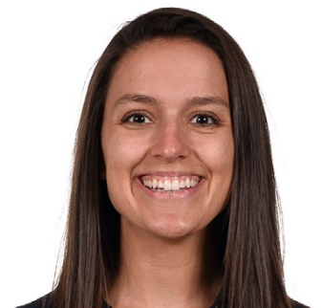
Jenna Robinson M.D., M.S. | Claire Slevin M.D. | Hannah Smith M.D., M.S. | Lauren Smith M.D., EdM
Hometown: Downingtown, PA & Brant Lake, NY
Medical School: University of Minnesota
For Fun I: I like to hang out by the water, go for runs and walks, read, and kayak! On my free weekends, I love taking trips to the beach!
Why did you choose Hopkins? I chose Hopkins because I wanted to receive a top training experience that would fully prepare me for my future career. There are so many opportunities at Hopkins to get involved in whatever subject interests you. To top it off, the faculty and residents are so welcoming and supportive and always strive to make our residency experience excellent!
What excites you most about living in Baltimore? I love the nearly 300 acre Patterson Park that’s in the heart of Baltimore where most of us live. There are so many walking paths and trees! I also love the harbor because it’s so fun to watch the boats and there are always activities going on. The famous aquarium is also definitely a routine outing!
She/Her
Hometown: Arlington, VA Medical school: University of Virginia
For Fun: I love to read (mostly fiction, mysteries, romcoms and thrillers), knit, get outside for walks and runs, and spend time with family and friends!
Why did you choose Hopkins? One thing that stood out strongly to me on my interview day was the commitment to teaching and mentorship from faculty and upper level residents. Hopkins provides such a wide range of opportunities for residents in all areas of clinical and non-clinical interest that I felt being here would help me find a career path that I love. Also, Hopkins works very hard to have a high level of resident continuity in our weekly continuity clinic. Because I don’t know exactly what I want to do after residency in terms of hospital vs outpatient medicine, I was excited to have an opportunity to truly have patients of my own that I follow over the course of three years. Lastly, while serving patients from all over the country and the world, I felt that the Harriet Lane residency was truly committed to community outreach and serving the pediatric population of Baltimore.
What excites you most about living in Baltimore? I love being able to walk to the water, parks in the city and many different neighborhoods. The food is great and I’m trying to make my way to all the best bakeries around the city!
She/Her
Hometown: Ardsley, NY
Medical School: SUNY Upstate College of Medicine
For Fun I: cook, bake, exercise(love trying new sports), do puzzles(jigsaw and crossword) and hang out with my family/friends
Why did you choose Hopkins? After my interview day I really felt that the Hopkins program truly cared about each of their residents and their individual careers, goals and lives. Since coming here I have realized that this culture of caring for and supporting residents both in their career/training and in their outside lives has held true. I was excited to come to a program that seems to care about the whole person whether that be their patients or their residents.
What excites you most about living in Baltimore? I am still new here, but I am really excited to explore the city and all it has to offer! I am also really excited for the weather compared to Upstate NY winters.
She/Her
Hometown: Buffalo, NY
Medical School: University at Buffalo
For Fun I: spend time with friends and family, stay outside as much as possible (running, biking, hiking, playing a variety of recreational sports), cheer on the Buffalo Bills, and read non-fiction
Why did you choose Hopkins?: The opportunity to be trained in both pediatrics and anesthesiology, the emphasis on education for residents and by residents, the friendly relationships between faculty, staff, and co-residents, and the ongoing dedication to the surrounding community
What excites you most about living in Baltimore? Exploring the different neighborhoods and communities throughout the city, trying new foods and restaurants, hiking in nearby parks
She/Her

Slide 9
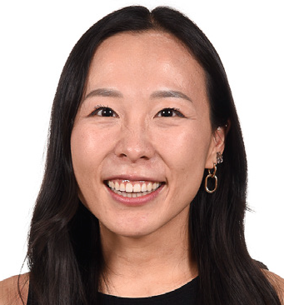
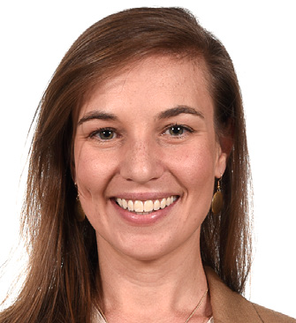
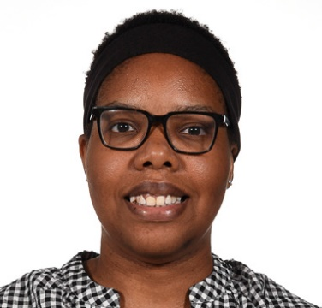
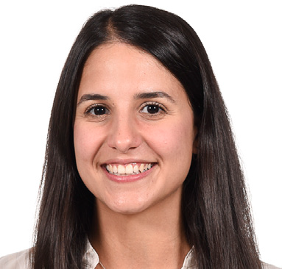
Sarah Song M.D. | Bailey Sperry M.D., M.A, | Kristin Torroella M.D. | Janet Umenta M.D.
Hometown: Flower Mound, TX
Medical School: University of Texas Houston For Fun I: like to run, catch a spin class, bake cute cakes, binge watch shows (or binge read). Movie nights are my absolute favorite way to spend an evening, and grocery shopping brings me more joy than it should. Why did you choose Hopkins? I chose Hopkins because of the sense of belonging and (professional) family I got from interview day. I felt (and still feel) like Hopkins cares about my learning and my growth - both as a physician and as a person - as passionately as they do about patient care. And I know that care will extend beyond my time physically at Hopkins. Because once you're part of the family, they got your back.. What excites you most about living in Baltimore? Being outside of Texas for the first time and being able to walk to places (including work and BMore Licks)
She/Her
Hometown: Philadelphia, PA
Medical School: Lewis Katz School of Medicine at Temple University
What excites you most about living in Baltimore? Old Bay, getting to take public transportation, being near the water
She/Her
Hometown: Hialeah, FL
Medical School: George Washington School of Medicine
For Fun I: cook, bake, read, binge watch TV, run or explore outside! I also love trying new restaurants and new ice cream places!
Why did you choose Hopkins?: I loved how warm and welcoming everyone was on my interview, how supportive they were of each other and the emphasis on education! I also love the diverse patient population and communities within Baltimore that I would get to treat. The global health emphasis and opportunity to go abroad was also extremely important to me.
What excites you most about living in Baltimore? Getting to explore a new city especially the food scene!
She/Her
Hometown: Queens, NY
Medical School: Jacobs School Of Medicine And Biomedical Sciences - University at Buffalo
For Fun I: I enjoy reading, writing, indoor rock climbing
Why did you choose Hopkins?: I chose Hopkins for the camaraderie and culture of teaching. I was fortunate to do an away rotation during my 4th year, and I immediately felt like home. What excites you most about living in Baltimore? Currently living in Fells Point! I enjoy the great restaurants, walking along the harbor, and the many places to get ice cream. I am excited to meet people from different fields and experience the great culture that Baltimore provides.
She/Her

Slide 10
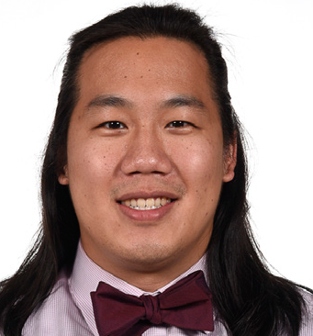
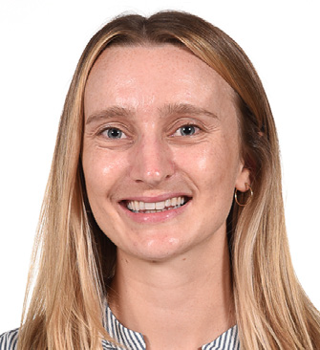
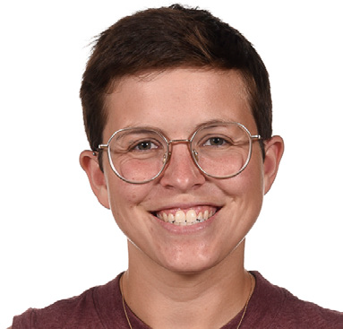
Victor Wang M.D., Ph.D. | Kimberly Whitney M.D. | Sophie Wilkins M.D., PhD
Hometown: Rockville, MD
Medical School: University of Connecticut For Fun I: Play video games, board games, tabletop roleplaying games. I also enjoy spending time with dogs, watching football or hockey, and exploring the local craft brewery scene. Why did you choose Hopkins? I wanted a place that would be able to provide me top notch training in Pediatrics and Genetics from both the clinical and scientific sides. Hopkins appealed to me as it offers an excellent academic training environment for both Pediatrics and Genetics, with high-powered research labs and preeminent physicians to work with that fit my physician-scientist path well. What excites you most about living in Baltimore? Close access to Patterson Park to walk the dogs, a vibrant city life that doesn't feel to big or stuffy, and coming back to a place where (blue) crabs are king.
He/Him
Hometown: Scituate, MA & Hull, MA
Medical School: Albert Einstein
For Fun I: Spend time outdoors hiking, biking, kayaking, etc., read anything unrelated to medicine, try new recipes (with variable success), play team sports (also with variable success), attempt arts & crafts (success unlikely), pet sit until I have one of my own!
Why did you choose Hopkins? I felt equally inspired by residents and empowered by leadership in the peds department at Hopkins. First was the value placed on medical education and scholarship, which is so clear in trainee-driven research and the program’s reliable commitment to excellence in its 23+ editions of The Harriet Lane Handbook. Next was the breadth of exposure to clinical environments and acuity, recognizing the honor it is to be entrusted with the care of patients from the Baltimore community and around the world. Most important, I appreciated that “Laners” at all levels could identify how Hopkins as an institution has enacted harm in its own neighborhood and contributed to structural inequities more broadly, while also clearly articulating a path forward, led by and for people of diverse lived experiences.
What excites you most about living in Baltimore? I love how walkable the city of Baltimore can be, which makes exploring its unique neighborhoods and trying out new restaurants, book stores, breweries, and museums all the more accessible for residents. Also, I love being right on the coast, a short trip to other major cities, and an even shorter trip to local nature!
She/Her
Hometown: Cortlandt, NY
Medical School: NYU Grossman School of Medicine
For Fun I: Ride horses (I compete in a niche sport called mounted games), run marathons, grow vegetables on my balcony, and cook lots of vegetarian and vegan food!
Why did you choose Hopkins?: I chose Hopkins for a combination of several reasons! I am a child neuro resident and I saw the amazing culture in both pediatrics and neurology during my interview day. I was also excited by the many research opportunities and flexibility to pursue them. Last but not least, Maryland is an amazing place to live if you have horses, which is my passion outside of medicine!
What excites you most about living in Baltimore? I live in Cockeysville, MD and I absolutely love that I can live in such a beautiful, green, horse-filled area while being less than 30 minutes from the hospital.
She/Her

Slide 11
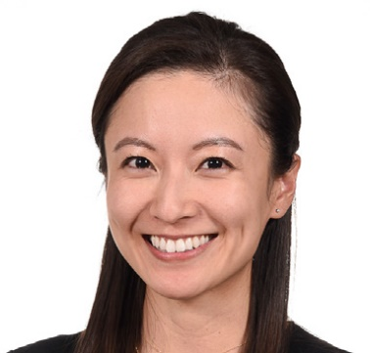
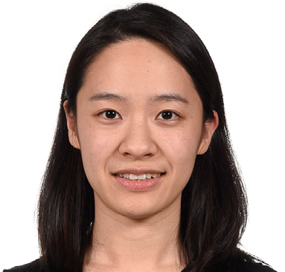
Pomi Yun M.D., M.P.H.
Christie Zheng M.D.
Hometown: Columbus, GA & Uijeongbu, South Koriea
Medical School: Medical College of Georgia
For Fun I: walk over to the pilates studio in my neighborhood, find new restaurants to try around the city, and love to go on walks and hikes!
Why did you choose Hopkins?: During my interview day, I was impressed by each of the presentations and teaching sessions that were led by the residents! And ultimately, I knew that Hopkins would create not only a strong clinical but also research foundation to support my interest in clinical trials.
What excites you most about living in Baltimore? Baltimore is uniquely close to a handful of major cities making it great for quick trips to either DC or NYC. Plus, you are surrounded by incredible food, hikes, and even beaches – highly recommend a visit if you’ve never been!
She/Her
Hometown: Guangzhou, China
Medical School: University of Virginia
For fun I: Explore local restaurants and different types of cuisine, spending time with my cat (Mocha), gardening, and traveling
Why did you choose Hopkins? I went to Hopkins for undergrad and absolutely loved my time here. I am thrilled to be able to return to Baltimore and begin my next chapter of training with an amazing group of residents! I also chose Hopkins because of the diverse patient population, the robust clinical training, and the many opportunities for clinical research.
What excites you most living in Baltimore: I lived in Baltimore for several years before medical school, so I am excited to go to my favorite spots in or near the city again! I am also excited to set up my new home with my partner and enjoy the beautiful Baltimore sunset from our patio!
She/Her

Slide 12
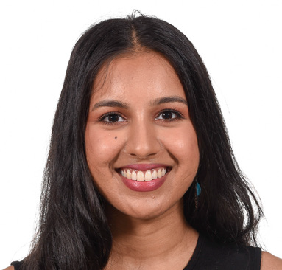
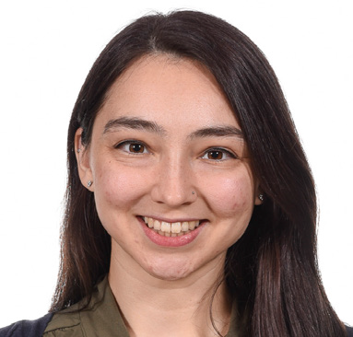
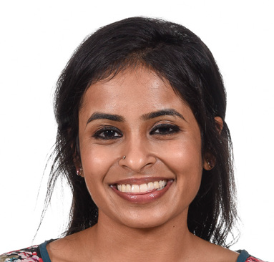
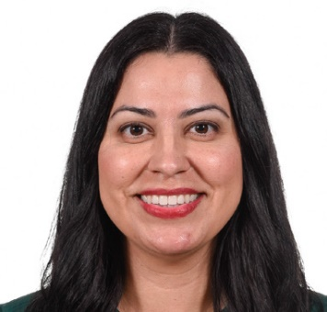
Sreeja Kodali M.D. | Anna Preston M.D., M.P.H. | Harrine Ramesh M.D., M.S. | Lauren Rosas M.D., M.Ed.
2nd Year Med-Peds Residents!
Hometown: Morganville, NJ
Medical School: Yale School of Medicine
For Fun I: cook Indian food, call my family, wear pajamas, watch bad Netflix rom coms, dabble in knitting
Why did you choose Hopkins? I chose med/peds at Hopkins for the Urban Health program with its built-in electives such as addiction medicine, HIV/HCV medicine carceral medicine and a mission-driven, primary care oriented community!
What excites you most about living in Baltimore? I'm excited about the diversity of the city, the diversity of the neighborhoods, living by the water (which is beautiful!), and being within driving distance of my family (in New Jersey!)
She/Her
Hometown: New Haven, CT
Medical School: Yale School of Medicine For Fun I: hit the boxing gym, play with my cat, or read a book! Why did you choose Hopkins? I chose Hopkins for its extraordinary intersection of excellence in cutting-edge clinical medicine and deeply invested, community-based care. What excites you most about living in Baltimore? I love being on the water, and I'm excited to explore all of the many bookstores and coffee shops! I hope to find the very best of each before I graduate.
She/Her
Hometown: Columbus, OH
Medical School: Case Western Reserve University
For Fun: watch old 90s/early 2000s sitcoms like they're new with my husband, ZUMBA , explore local Metro/National parks (waterfalls are my favorite!), enjoy going to bible studies and church with friends
Why did you choose Hopkins? I was looking for a program that was both clinically rigorous and committed to making me the best urban primary care doctor I could be. At Hopkins, you won't get very far just by knowing the best treatment plan for your patient. You must learn your community, their history and earn your patients' trust if you hope to deliver the best care. I wanted the privilege of caring for this resilient city.
What excites you most about living in Baltimore? The fact that most conversations end in "have a blessed day!" , The incredible diversity of cultures and nationalities. The relatively low cost of living and traffic volume compared to other cities. But, if you miss these things, DC and NYC are so close!
She/Her
Hometown: Pico Rivera, CA & Los Angeles, CA
Medical School: UCLA David Geffen School of Medicine
For Fun I: like to travel, hike, nap, and eat delicious food (not necessarily in that order!)
Why did you choose Hopkins?: I chose Hopkins because of the unique Urban Health curriculum and the opportunity to train with some of the most amazing clinicians in the world. I knew that training here would prepare me to be the best clinician I can be. And fortunately, people have been incredibly kind and welcoming thus far.
What excites you most about living in Baltimore? Everything! This is my first time living on the East Coast, so I am appreciating the new architecture and geographic landscape, as well as the diverse population of the city.
She/Her

