Slide 1
Intern Class 2024-2025

Slide 2
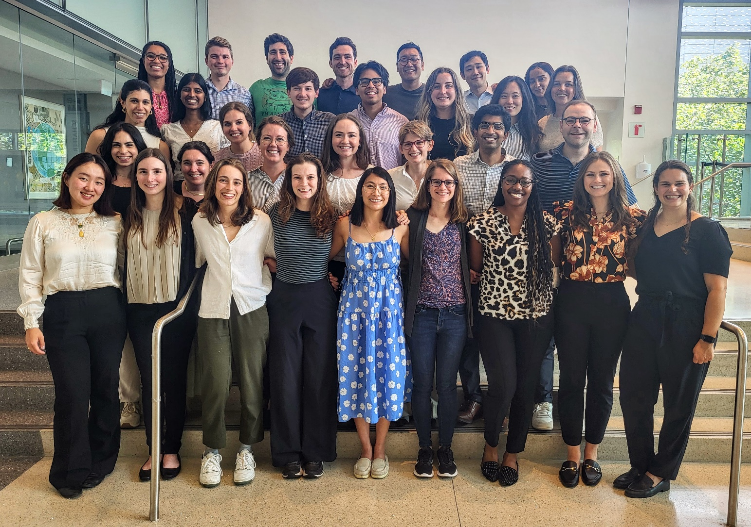
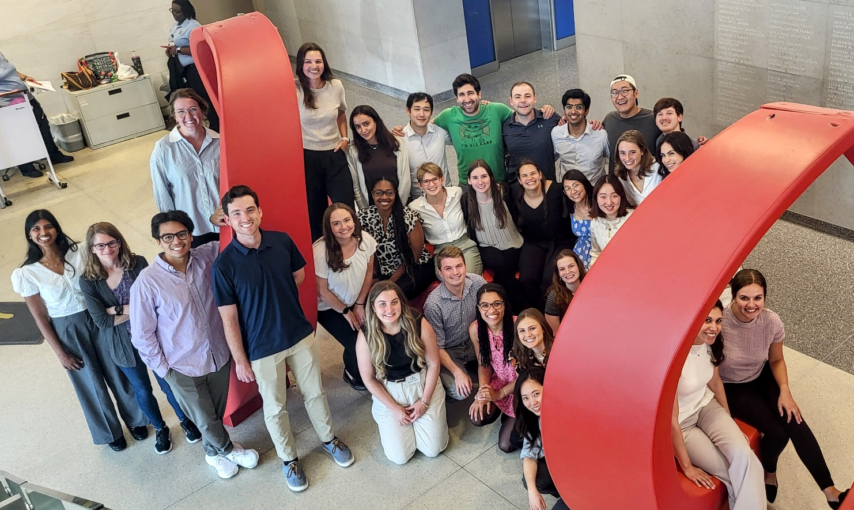

Slide 3
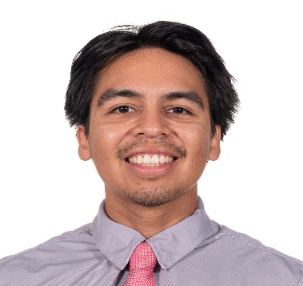
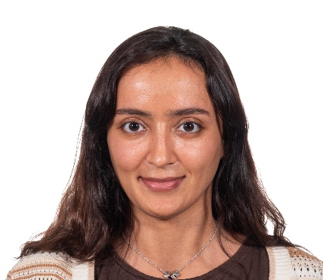
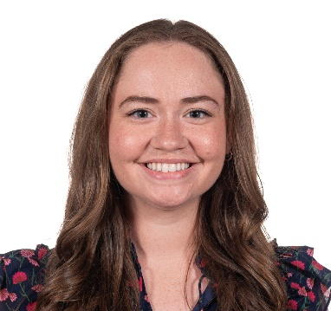
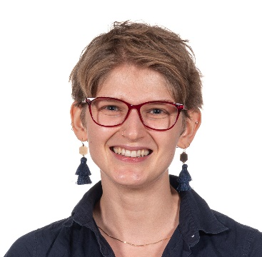
Luis Acosta M.D. | Fatima Al Khyeli M.D. | Julie Alejo M.D. | Abby Cahill M.D., M.P.H.
Hometown: Hendersonville, NC
Medical School: The University of North Carolina at Chapel Hill School of Medicine
For Fun I: Be ACTIVE!!! I like to go to the gym, play basketball, coach (former Public Middle School Coach!) basketball, play pickleball, play tennis, and watch all sports (mainly basketball). Outside of being active, I love to explore new areas + restaurants, spending time with friends & family, and cook.
Why did you choose Hopkins: I chose Hopkins because of the alumni, family-like energy I felt amongst the residents and residency program staff and faculty, and for the unique opportunity to work at the Latino Clinic at Yard56!!! I participated in the Johns Hopkins Visiting Elective Program to Promote Diversity, Equity, and Inclusion in Pediatric Healthcare and this gave me a glimpse into what my residency training would be like!!!
What excites you most about living in Baltimore: To be able to live in a more Urban environment! Living in a city like this is a first for me but also excited more parts of the city! Different neighborhoods have different energies, and the most surprising thing to me has been how walkable the city can be! Patterson Park and the Harbor area are currently my favorite spots but looking forward to exploring more!!
He/Him
Hometown: United Arab Emirates
Medical School: United Arab Emirates University
For Fun I: I enjoy traveling, reading, sketching/painting, attending concerts and having outdoor picnics
Why did you choose Hopkins: As a Neurodevelopment Disabilities applicant, I chose JHH/KKI for its comprehensive clinical and academic training, as well as the supportive faculty, leadership and residents. What excites you most about living in Baltimore? I’m mostly excited about living near the wharf, the beautiful parks, music festivals, hiking trails and national parks in the DMV area, as well as the proximity to different cities such as DC and NY.
She/Her
Hometown: Fallston, MD
Medical School: University of Maryland School of Medicine
For Fun: Love to spend time with friends and family, go on walks with my pup, and try new restaurants.
Why did you choose Hopkins: It's been a dream of mine to train at Hopkins ever since I volunteered at the children's center in high school. I knew I would receive top-notch training here that will set me up for success in my career. It was also important for me to go through residency in a place close to my support system. After interview day, I knew it was the best place for me!
What excites you most about living in Baltimore: Baltimore has everything you could need while being affordable to live in! I love being close to the water and just a short trip away from other big cities on the East Coast. I also love the variety of neighborhoods in Baltimore, and even though I’ve been here since college, I still find new places to explore every weekend.
She/Her
Hometown: Eagan, MN
Medical School: Tulane University School of Medicine
For Fun: I like to run and do anything outdoors (when it's not too hot), cook, eat other people's baked goods, watch historically-inspired TV shows, and read non-medical books!
Why did you choose Hopkins: It's cliche but I chose Hopkins because of the pediatric/anesthesia combined program and the people! I found it was one of the few places that has people truly practicing a combined career in both fields with an emphasis on taking care of the people in the Baltimore community. It didn't hurt that the people were super friendly and excited about all of the things I'm interested in as well! What excites you most about living in Baltimore: I'm most excited about being in a walkable city with so much history! I love the community feel of East Baltimore and the ability to be close to so many good restaurants and bars and beautiful architecture.
She/Her

Slide 4
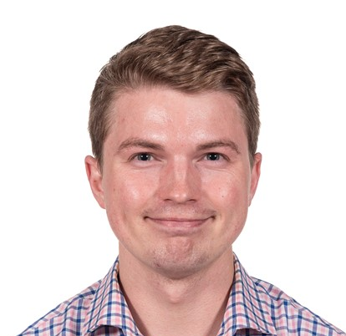
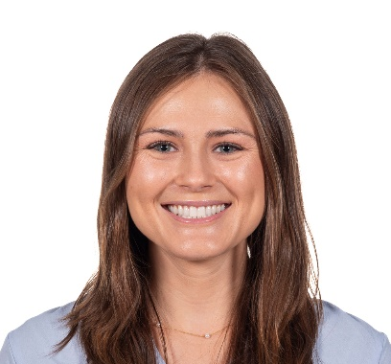
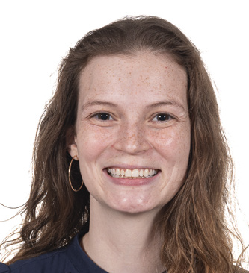
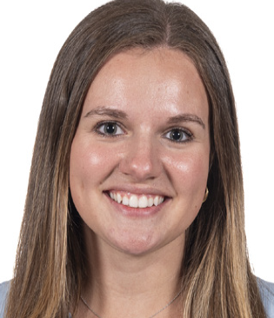
Briggs Carhart-Veres M.D., M.P.H. | Rachel Carr M.D. | Naomi Cohen M.D. | Kaitlin Conner M.D.
Hometown: Phoenix, AZ
Medical School: Dartmouth
For fun I: Enjoy walking my dogs, hike various locations, and board games with my partner and friends!
Why did you choose Hopkins?: The breadth and depth of clinical experiences is absolutely phenomenal. With the high degree of patient complexity (with still good exposure of "bread & butter"), the academic training is rigorous but the program leadership is extremely supportive and the residents know how to have fun! The residents have a strong voice in the advocacy work in primary care clinic and throughout the community. The resident community at Hopkins is fabulous and kind. My co-residents are extremely knowledgeable with fantastic inter-personal skills. They are all already leaders in pediatric communities and I am grateful to be learning alongside them.
What excites you most about living in Baltimore? Baltimore is a prime east coast location with its strong arts and recreation culture. I am able to go inland to hike or to explore the vast waters in the harbor. The easy travel to DC and Philly and other coastal cities is awesome!
He/Him
Hometown: Gulf Breeze, FL
Medical School: Florida State University College of Medicine
For Fun I: For fun I love spending time outdoors, walking around Fells Point, playing any sport (pickleball, tennis, etc.), watching scary movies, hanging out with my super awesome co-residents, and spending time with my cat:)
Why did you choose Hopkins?: I chose Hopkins because their program had the perfect balance of incredible training, program support, and a close-nit family of co-residents. The program emphasizes the importance of graduated autonomy and support from your senior residents while working as an intern. This creates a very healthy learning environment where I am able to grow as an independent physician but always have help and guidance when needed. I’m not sure what my future pediatric career holds, but I know my training here will open endless doors and opportunities in whichever specialty I choose! The closeness of the residents was also very important to me because I was nervous about moving to a new city far from home. I am so happy I chose here because my co-residents have already become my best friends and an amazing support system!
What excites you most about living in Baltimore? I love living in a city with so many different cultures and things to do! I have already eaten at countless amazing restaurants since being here, and I love walking around different neighborhoods like Fells Point and Patterson Park. Also, coming from Florida, I am so excited to actually see the seasons change and maybe finally get to have some snow!
She/Her
Hometown: Cleveland, OH
Medical School: University of Toledo
For Fun I: like to hike, kayak, and travel during my free time. I also love painting, reading, gardening, and yoga.
Why did you choose Hopkins? I chose Hopkins because of their focus on serving and advocating for others. I was very excited to take part in their Yard 56 clinic and further my Spanish skills. I am also hoping to take part in rotations abroad to learn more about the opportunities available to serve globally. I feel that everyone at Hopkins is working towards the betterment of the community and they are not afraid to advocate for their patients.
What excites you most about living in Baltimore? After living in Ohio my entire life, I was very excited to move to a new city. I absolutely love Baltimore and I am constantly finding new things to do and places to go. I really appreciate how the city is walkable and I love living in Fells Point. I also feel the city is very unique and I love all of the small restaurants, farmers markets, and shops!
She/Her
Hometown: Dallas, Texas
Medical School: UT Southwestern
For Fun I: like to garden, sew, hike, and hang with friends and family.
Why did you choose Hopkins? the amazing research and clinical opportunities
What excites you most about living in Baltimore: All of the great parks!
She/Her

Slide 5
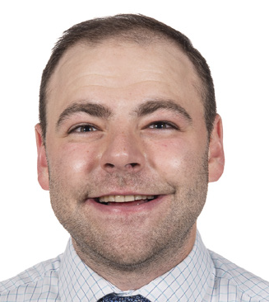
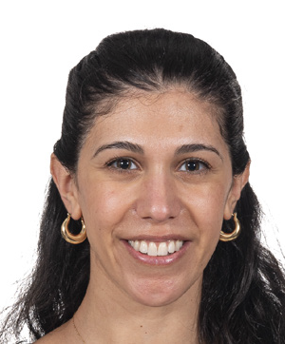
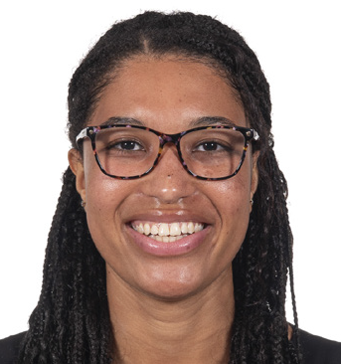
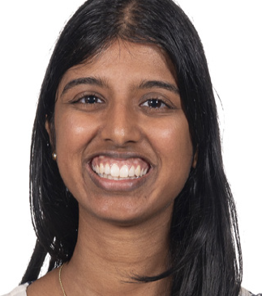
Sarah-Thérèse Curtis Welling M.D. | Rachel David M.D., M.P.H. | Steve Gercken M.D. | Lea Ghastine M.D., M.P.H.
Hometown: Bel Air, MD
Medical School: University of Maryland School of Medicine
For fun I: I love to be outside - running, hiking, sports (basketball, beach volleyball, tennis, pickleball)! I also love watching my favorite sports teams (Ravens, O’s, Penguins, UVA basketball) and checking out new breweries / restaurants with my lovely partner Lauren and our friends!
Why did you choose Hopkins? I was so excited to match at Hopkins for the amazing clinical training and the opportunity to continue serving the pediatric population in the city I love! As someone interested in primary care / general pediatrics, I knew that Hopkins would provide outstanding clinical experiences both in the hospital and in the clinic. My interview day sealed the deal - the people are awesome!
What excites me about Baltimore: The restaurants, being so close to so many parks / green space and the water, living close to family and friends, being able to walk to the Ravens / O’s stadiums to watch my favorite teams!
He/Him
Hometown: Cincinnati, OH
Medical School: The Ohio State University College of Medicine
For fun: I enjoy reading, playing piano and violin, streaming the latest TV series, trying out new restaurants, and spending time outdoors
Why did you choose Hopkins? I chose the pediatric residency program at Hopkins for its focus on resident education, broad exposure to subspecialty care, the location, and the abundant research opportunities.
What excites me about Baltimore: I really enjoy walking along the waterfront and exploring the food scene in Baltimore!
She/Her
Hometown: France/Guinea; grew up in Bethesda, MD
Medical school: University of Maryland School of Medicine
For fun I: love to travel and try foods from different cultures and places around the world, playing pickleball and racquetball with my husband, and run with my mom who's better/faster than me!
Why did you choose Hopkins? I love the culture of teaching that is so widespread at Hopkins. Everyone is so enthusiastic about partnering with you and making sure we understand why we do what we do for our patients. I also love working with the diverse Baltimore populations that make up this beautiful city!
What excites you most about living in Baltimore?:I love living by Patterson Park and joining Volo leagues around the city! Also, my husband and I are big ice cream people and have always lived within a few blocks to a B'more Licks ice cream spot!
She/Her
Hometown: Austin, Texas
Medical School: University of Texas Medical Branch
For Fun: love trying new restaurants and boba, photography, reading, and spending time outdoors!
Why did you choose Hopkins? I am excited for the opportunity to learn and grow from the diverse population Hopkins serves as well as from the public health and global health resources and experts that are here. The continued work toward health equity and mindfulness of current challenges is something I appreciated seeing here and am looking forward to being a part of!
What excites you most about living in Baltimore? This is my first time living outside of Texas, and I'm excited to see and explore all the food, nature, and so much more that makes Baltimore special! (and snow? I don't think I'm ready)
She/Her

Slide 6
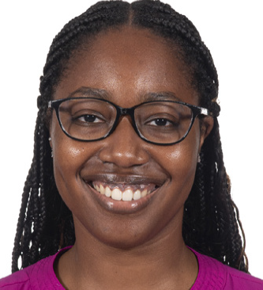
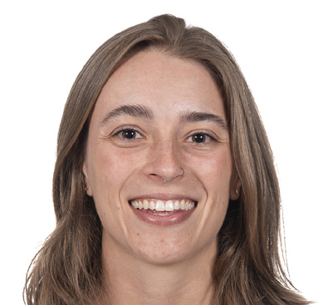
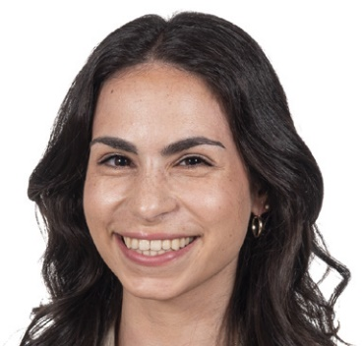
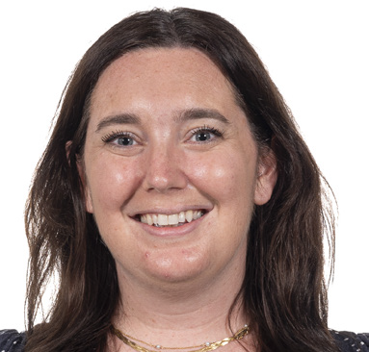
Mikaela Gold M.D. | Emma Johnson M.D. | Alyssa Lillian M.D. | Danielle McAuliffe M.D.
Hometown: Huntsville, AL
Medical School: Meharry Medical College
For Fun I: Love to travel, go to concerts, binge-watch a good crime drama, new hobby pickleball, cheer for all things Mississippi State.
Why did you choose Hopkins? Hopkins is the premier institution for pediatrics. I wanted to be somewhere that was intentional about uplifting diverse voices. It was equally important to me to be part of a community that values diversity not only among residents and fellows but also at the faculty level. The patient population served by Hopkins aligns perfectly with my mission of advocating for the underserved and gaining the expertise to handle complex medical situations. As a Health Equity resident, we get to learn how to address health disparities through multiple lenses of local advocacy, public health, and also at the national legislative level which is unique. I also had the opportunity to do a visiting elective in medical school and I knew then where I wanted to be after only the first week. All of my interactions felt so genuine and I was welcomed with open arms. It was beyond easy to choose my family for the next three years.
What excites you most about living in Baltimore? I have very fond memories of my mother taking me to the Inner Harbor during the summers growing up. The city seemed so enormous to me then, and I always yearned to revisit it someday. Now I live here and can explore everything Baltimore has to offer. It’s refreshing being in a waterfront city, not to mention the incredible seafood!
She/Her
Hometown: Sarasota, FL
Medical School: University of South Florida
For fun I: read, hike, hang out with my partner and our pets, cook, bake, eat, go to live music, travel (to hike/eat), hang out with friends and family
Why did you choose Hopkins: I chose Hopkins because I got to do a sub-i here and felt like it was a great fit for me. I loved all the people I worked with and the city! I also felt like I'd get a really great education given the breadth of patients we get to care for and meet, as well as the opportunities we get to work with medical students.
What excited you most about living in Baltimore: So many things!!! I'm excited to be in a city with access to all the restaurants, concerts, museums, big airport, etc. that cities have to offer, while still have a ton of green spaces and be able to go hiking easily. It's a great size; it has all the fun things without being overwhelmingly big (and you can easily get to DC, Philly, and New York if you want). Plus I have family here in Baltimore and my sister only lives an hour away!
She/Her
Hometown: East Brunswick, NJ
Med school: Rutgers NJMS
For fun: Love trying new restaurants, flying planes with my uncle, and hosting board game nights!
Why did I choose Hopkins: I met so many wonderful people on my interview day and during the in person second look with such incredible passion for teaching and drive to help each other succeed and knew that I belonged here.
What excites you the most about living in Baltimore: Buying new plants & other things I don't need every Sunday at the Farmers Market :)
She/Her
Hometown: Annapolis, MD
Medical School: Penn State College of Medicine
For Fun I: I like to spend time outside and enjoy running, playing lacrosse and pickleball, boating, and going to the beach.
Why did you choose Hopkins? On my interview day, I loved the supportive and team-oriented culture among the residents and faculty. I wanted to be a part of a program that both challenged me and inspired me to become the best version of myself. Through talking with the residents and previous Harriet Lane alums, it was clear how much they felt being a part of this residency program positively impacted their careers in pediatrics. I am also thankful to be close to family.
What excites you most about living in Baltimore? I am excited to explore all that there is to do in Baltimore. I have enjoyed being so close to the water and finding great restaurants.
She/Her

Slide 7
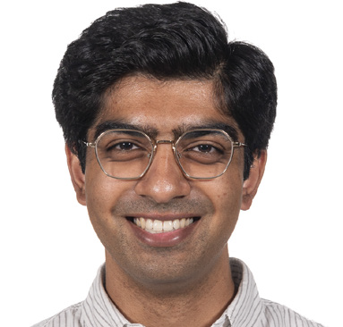
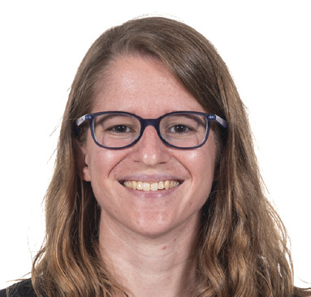
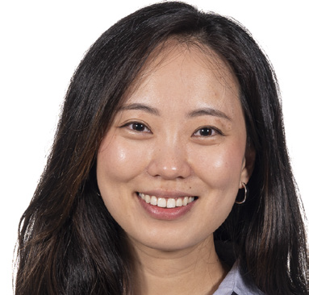
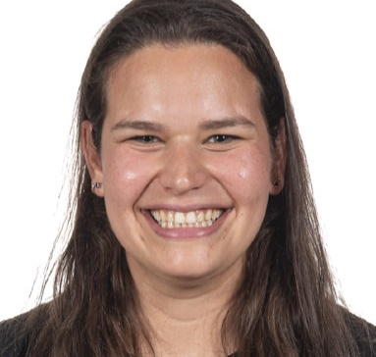
Pranav Nandan M.D., M.P.H. | Meghan Orr M.D., PhD | Christin Park M.D. | Gabby Pollack M.D., M.P.H.
Hometown: Garrett Blue Bell, PA
Medical School: Saint Louis University School of Medicine For Fun I: Spend time with my fiancée and dog, play tennis, run, and add to my plant collection
Why did you choose Hopkins? I chose Hopkins and the Health Equity track for the opportunities to care for patients across the full spectrum of pediatric illness, to get to know Baltimore City, and to develop my advocacy skills so that I can better serve my patients and their families. I was also drawn to the community — everyone I met here was so warm, welcoming, and excited to teach!
What excites you most about living in Baltimore? Getting a chance to explore a new city and try a whole bunch of restaurants!
He/Him
Hometown: Nashville, IL
Medical School: Northwestern
For Fun I: run, hike, climb, read, play music
Why did you choose Hopkins: Hopkins combines a world-class environment for research with a diverse and largely underserved patient population, fostering my ability to begin my physician-scientist career while keeping me grounded in the daily realities of practicing medicine.
What excites you most about living in Baltimore? The big boats
She/Her
Hometown: Fairfax, VA
Medical School: Johns Hopkins University School of Medicine
For Fun I: Love walking my dog, Sesame by the water!
Why did you choose Hopkins? I thought this program would be an excellent way for me to learn pediatric medicine during intern year as a future child and adolescent psychiatrist.
What excites you most about living in Baltimore? Tons of waterfront and great restaurants!
She/Her
Hometown: Long Island, New York
Medical School: The Donald and Barbara Zucker school of medicine at Hofstra/ Northwell
For Fun I: love to hike, run, bike, check out new coffee shops and restaurants! Why did you choose Hopkins? Every interaction I had with the residents at Hopkins made me so excited to come here! From the night before the interview at the social event, to the interview day itself, to talking to some residents afterward, I was so impressed by the support and care they all had for each other and the children of Baltimore. I knew I wanted to train at a program where people were thinking deeply about medicine, research, social justice, and public health.
What excites you most about living in Baltimore? I have loved my first few months in Baltimore! I love how close we are to nature, including the water and many biking and running trails. I also love all the cafes and restaurants I have been exploring! =)
She/Her

Slide 8
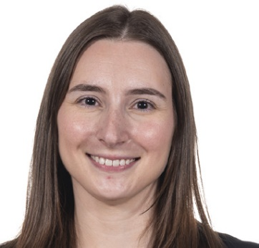
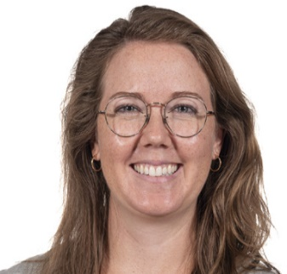
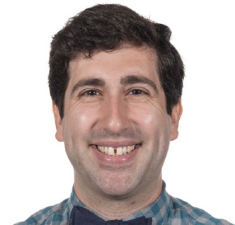
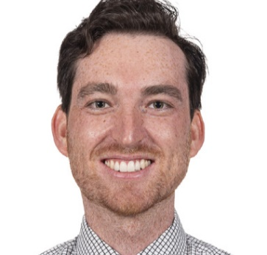
Joseph Posner M.D., PhD | Peyton Russell M.D. | Jessica Vitale M.D. | Taylor Walters M.D., M.P.H.
Hometown: Resiterstown, MD
Medical School: Georgetown University
For Fun I: rock climb, play Dungeons and Dragons, and cook fancy meals for my friends and family!
Why did you choose Hopkins? I wanted to have the opportunity to learn from some of the best phsicians and researchers in the world, and at the same time, to live and work where I grew up.
What excites you most about living in Baltimore? I love being in a city that has such a strong feeling of community. Form the sports teams, to the arts scene, to each individual neighborhood, everywhere you go there is a strong sense of Baltimore pride!
He/Him
Hometown: San Francisco (more or less) Medical school: Medical University of South Carolina
For Fun: Like to hike, sail, fish, read, bake, walk my dog, Bailey, and search for the world’s best burrito.
Why did you choose Hopkins? Exceptional training and academic opportunities coupled with community-centered care in a vibrant city with folks come from all walks of life. I loved that Hopkins also offered a variety of opportunities to take care of underserved populations both here in Baltimore and across the country and globe. Additionally, I felt so welcome during my interview. Few programs of this caliber were able to convey the warmth and sense of community that Hopkins did during the interview season.
What excites you most about living in Baltimore? Great food, proximity to mountains and beaches, and being close to some of my family in DC!
He/Him
Hometown: Villanova, PA
Medical School: Sidney Kimmel Medical College at Thomas Jefferson University
For Fun I: love painting, jigsaw puzzles, crossword puzzles, cycling, exploring new areas of the city, ice cream walks along the harbor!
Why did you choose Hopkins? "When applying for residency, I knew I wanted a program with strong clinical training and robust research, that valued health equity and community involvement, and was a designated trauma center with a level IV NICU. I also wanted a program size where I would know all of my co-residents and leadership faculty – Hopkins was the perfect fit. I had met Hopkins alumni in various stages of their careers, all of whom raved about their training experiences and were leaders in pediatric medicine. I knew on my interview day that Hopkins was where I wanted to train to be a pediatrician. The residents I met during my pre-interview social were so easy to talk to and were so happy with their residency experience. The meaningful, personalized conversations I had with program leadership (PD, PCs, APDs) and faculty on my interview day solidified that this was a program that would empower me to become the physician I aspired to be. Now that I’m here as an intern, the supportive, tight-knit culture continues to amaze me, and the dedication to our patients is contagious. I’m so grateful to be a part of this program! "
What excites you most about living in Baltimore? I love living by the water and the diversity and culture of the city! It's really the best of both worlds in terms of a city/downtown area along with the convenience of drivability to Target/grocery stores! I’m always learning about fun new areas of the city from my coworkers and patients :)
She/Her
Hometown: Palmyra, Virginia
Medical School: Virginia Commonwealth University School of Medicine
For Fun I: love to hike, especially in a state or national park! Bake, play pickleball, explore a new city, sing early 2000s pop punk at karaoke
Why did you choose Hopkins?: I was looking for a program with a well-established global health program and Hopkins was that and so much more! The leadership of the program is dedicated to training well rounded pediatricians, the residents were kind and welcoming, and the Children’s Center had all the subspecialists and advance technology to expose me to the full breadth of the field. I knew that having trained at Hopkins would open the doors to any interest I wanted to pursue, both clinically and in the public health sphere.
What excites you most about living in Baltimore? Becoming a local at my new favorite wine shop, coffee bar, and hiking trail!
She/Her

Slide 9
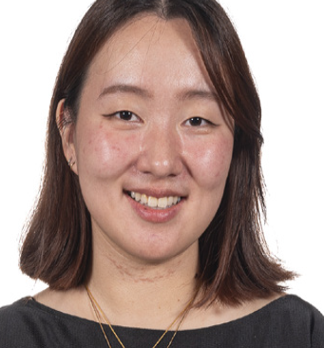
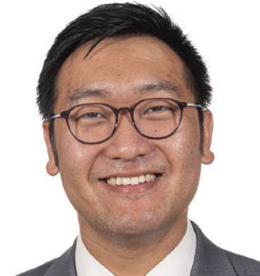
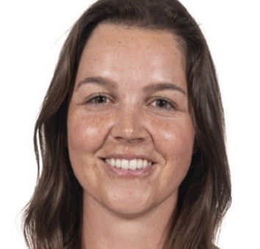
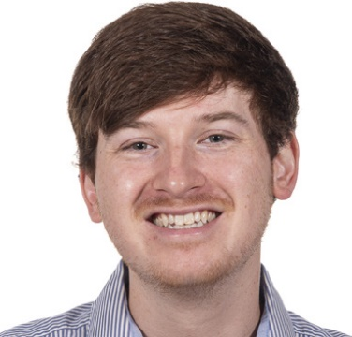
Anna Wang M.D. | Austin Wang M.D. | Sam Waslewski M.D. | Daniel Woodhead M.D.
Hometown: Novi, Michigan (Metro-Detroit Area!)
Medical School: Northwestern University Feinberg School of Medicine
For Fun I: Play board and video games, explore bars and restaurants with friends (or anything with friends -- I'm a yes man), run and lift, cook fun dishes, and do photography. I'm also getting into being a plant dad!
Why did you choose Hopkins: I'm one of the pediatrics/anesthesiology residents (with the goal of practicing pediatric critical care medicine and pediatric anesthesiology) and selected Hopkins because I knew that this is where I would feel most at home. Both departments independently have incredible educational opportunities, abundant resources, and a heavy focus on critical care independently. Additionally, more specific to my own relatively rare interest, it is one of ~3 hospitals in the country where there is an abundant volume of trainees, faculty, and mentors who have their feet in both PICU/peds and anesthesia. Even relatively large children's hospitals typically only have ~1-2 of these dual-trained type individuals, so it's exceedingly rare to be at an institution like Hopkins where we are so supported and culturally accepted. I have loved all of my co-ressies, seniors, and faculty and am so thankful to be here! It is so awesome to be at a place where I just feel at home both because my co-residents feel like family and because the program supports my training interests/goals with open arms.
What excites you most about living in Baltimore? A vibrant urban culture where all hobbies are uplifted (great bars, art scene, running scene, food, rec sports, etc.)!
He/Him
Hometown: Scottsdale, Arizona
Medical School: Virginia Commonwealth University (MCV)
For Fun I: do anything I can with my dog! I have a 3 year old Golden Retriever named Maverick. We love walks, hikes, parks, and restaurants patios.
Why did you choose Hopkins? Hopkins seemed to offer the perfect blend of allowing me to pursue my individual career goals while still maintaining a community of support and positive learning experiences. (And can confirm now that is 100% true!)
What excites you most about living in Baltimore? This city is so dog friendly! There are so many places that welcome and cater to pets. Maverick and I have had so much fun exploring our new home, especially the dog menus ...
She/Her
Hometown: Pittsburgh, PA
Medical School: West Virginia University School of Medicine For Fun I: Love cafe-hopping and exploring cool places around the city, picking up random hobbies, and taking walks at sunset. I am holding back on visiting the SPCA because I know I'll be walking out with a cat if I go. Why did you choose Hopkins? From first impression and even after coming here, I can feel that everyone is cognizant of, and trying to bridge, the health equity gaps that exist in the community. Understanding that these would be very formative years in my training, I wanted to be somewhere where I could grow not only in my medical care, but also through cultural consciousness and advocacy. What excites you most about living in Baltimore? I'm excited to finally be in a bigger city! I live in Fells Point, and there's so much to do all within walking distance. I am looking forward to explore all of the lil unique neighborhoods in Baltimore!
She/Her
Hometown: Peachtree City, GA
Medical School: Drexel University College of Medicine
For Fun I: Spend time with my wife and daughter, cook, try new restaurants, obsess over college football
Why did you choose Hopkins?: As someone who is interested in pursuing sub-specialty training, Hopkins was the ideal program for both exposure to high patient volume and acuity and unmatched opportunities for academic involvement.
What excites you most about living in Baltimore? All the amenities of a living in a city but with less of the traffic and crowding that comes with some bigger cities.
He/Him

Slide 10
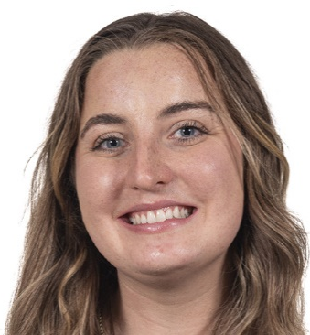
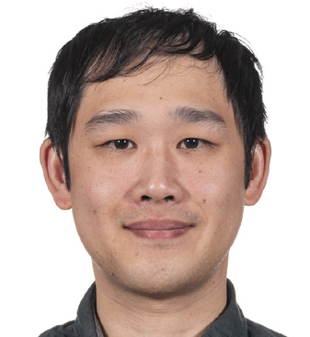
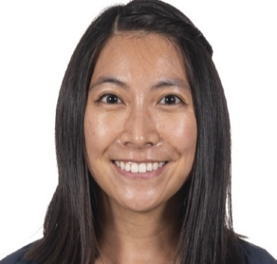
Madelynne K. Wright M.D. | Eric Yau M.D., PhD | Charmaine Yuan M.D.
Hometown: Monrovia, Indiana
Medical School: Indiana University School of Medicine For Fun I: I love being outdoors whether it is running, hiking, camping, or going to the beach! I also love baking, doing puzzles, watching basketball, and listening to Taylor Swift! Why did you choose Hopkins? I wanted to attend a program that understands the importance of advocacy and investment in the community in which we serve. I am interested in primary care and wanted to be at a program that encourages this and fosters my growth a general pediatrician. What excites you most about living in Baltimore? The food! There are so many wonderful places to eat in the city. I have a spreadsheet of every place I want to try.
She/Her
Hometown: Placentia, CA
Medical School: Penn State College of Medicine
For Fun I: like to travel (especially road trips), try new restaurants with family and friends, and play Magic the Gathering.
Why did you choose Hopkins? I chose Hopkins because it would provide me a great environment to not only get great general pediatrics training, but also learn multiple facets of pediatrics due to its robust availability of sub-specialties. Furthermore, the environment supports and encourages research, which I aim to pursue as an integral of my career moving forward.
What excites you most about living in Baltimore? I really like the community in Baltimore. Having doing some of my schooling in Baltimore, I found the distinct neighborhoods to provide unique interactions between people. Despite the uniqueness of each neighborhood, I notice that many Baltimoreans are very welcoming, which is very evident across the many festivals and community events going on throughout the year.
He/Him
Hometown: Ellicott City, MD
Medical School: Johns Hopkins School of Medicine
For Fun I: enjoy reading, baking, hiking, travelling, and spending time with friends and family (including my two cats!)
Why did you choose Hopkins?: As a former medical student at Johns Hopkins, I was fortunate to be a part of the pediatrics team and work with current residents. One thing that always impressed me was how knowledgeable all of the residents were, starting from intern year. This, along with the various educational conferences I attended and the informal teaching I received from residents, demonstrated Hopkins’ commitment to clinical education. I also love the close community at Hopkins, with amazing residents and faculty who are supportive, kind and happy, with plenty of opportunities for mentorship. My current interests include primary care and addressing the social determinants of health (SDOH). I think the work that the Harriet Lane Clinic and Hopkins Community Connections is incredible, and I am excited about efforts to expand SDOH screening. I am also eager for the opportunity to work at the local community hospital St. Agnes and to experience rural health care with the Indian Health Service. Of course, I cannot forget to mention Baltimore! My family and partner are in the Baltimore region, and it will be wonderful to be near my support system during the next part of my journey. Despite growing up nearby, I love learning more about the city and hope to continue to explore the neighborhoods and the restaurants!
What excites you most about living in Baltimore? There is so much to do in Baltimore from restaurants to museums to beautiful parks. There is so much character and charm in the city and I can't wait to explore more with my co-residents!
She/Her

Slide 11
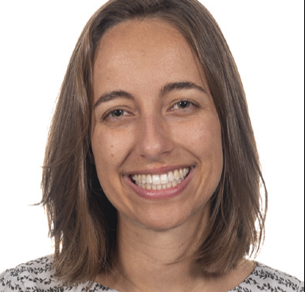
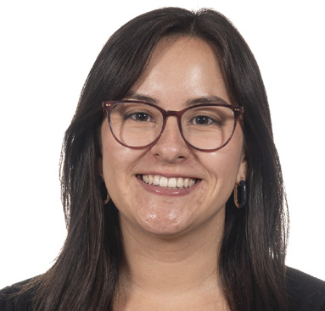
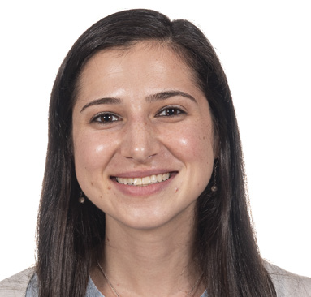
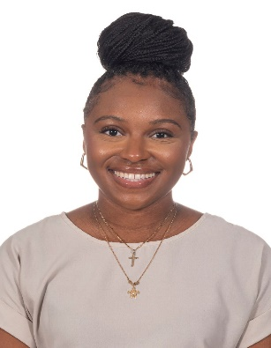
Anna Broshkevitch M.D. | Christy Lopez M.D. | Lydia Lutz M.D. | Erica Riddick M.D., M.S.
1st Year Med-Peds Residents!
Hometown: Purcellville, Virginia
Medical School: Virginia Commonwealth University
For Fun I: For fun, I enjoy reading, travel, and spending time outdoors! I also have 2 pet bunnies that keep me busy!
Why did you choose Hopkins? My goal in medicine is to help improve the health of underserved communities and I was drawn to the Johns Hopkins Urban Health program. I am excited to gain experience in fields such as mental health care, addiction medicine, and carceral medicine as a part of this program and to work in the EBMC clinic as a primary care provider!
What excites you most about living in Baltimore? Baltimore has a little bit of everything- the Chesapeake Bay, all kinds of delicious food, professional sports and a thriving arts scene. I'm excited to explore the city and have so many opportunities available!
She/Her
Hometown: Martinez, California
Medical School: Icahn School of Medicine at Mt Sinai For Fun I:Travel, run, play soccer Why did you choose Hopkins? The patients are incredible and the career opportunities What excites you most about living in Baltimore? The food!!! And the community
She/Her
Hometown: Glenview, IL
Medical School: University of Pennsylvania
For Fun: hike, run, bake, write, explore bookstores
Why did you choose Hopkins? Justice-oriented, community-centered urban primary care through the Med-Peds program
What excites you most about living in Baltimore? This city is weird in the best way; I’m discovering all these delightful oddities (like unlimited free books once a month). Also, top tier window cats that make early morning walks to the hospital infinitely more enjoyable.
She/Her
Hometown: Starkville, Mississippi
Medical School: Drexel College of Medicine
For Fun I: check out new skating rinks, binge watch makeup tutorial videos, scroll on Tik Tok for way too long!
Why did you choose Hopkins?: I was initially drawn to the institution because of its emphasis on community, scholarship, and education. I was also interested in providing care to a diverse community such as Baltimore.
What excites you most about living in Baltimore? diverse population; great food; fun activities
She/Her

