Slide 1
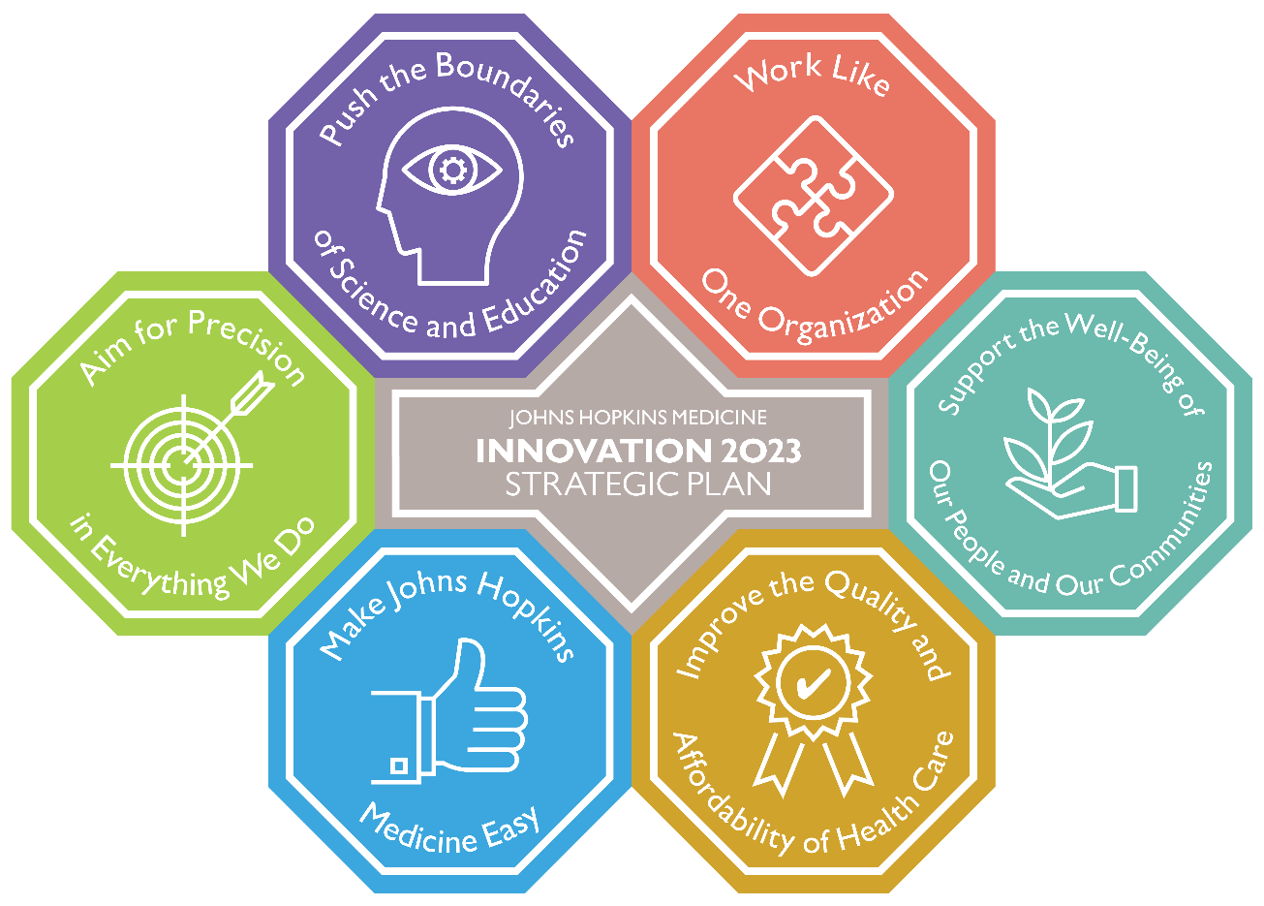
Johns Hopkins Medicine
Innovation 2023 Strategic Plan
FISCAL YEARS 2019 – 2023

Slide 2
Johns Hopkins Medicine
Innovation 2023 Strategic Plan
FISCAL YEARS 2019 – 2023
STRATEGIC GOALS
MAKE JOHNS HOPKINS MEDICINE EASY
Enhance the patient experience by improving access, navigation, communication and care transitions. Make it easy for all members of the JHM community to fulfill our mission.
SUPPORT THE WELL-BEING OF OUR PEOPLE AND OUR COMMUNITIES
Foster an organizational culture that is supportive, diverse and inclusive. Enhance joy at JHM. Grow our local community-engagement efforts to address identified needs that improve health.
PUSH THE BOUNDARIES OF SCIENCE AND EDUCATION
Enrich the environment for discovery and learning through continuous innovation. Invest in fundamental science and create new models of teaching, training and clinical care delivery.
IMPROVE THE QUALITY AND AFFORDABILITY OF HEALTH CARE
Maximize value for the patients we serve with an intense focus on quality, safety and efficiency. Strive for continuous performance improvement. Lead the national conversation and exchange of ideas around high-value care.
WORK LIKE ONE ORGANIZATION
Continue our tradition of leadership by becoming the model of an integrated health care delivery system. Share best practices and extend research and education across JHM venues.
AIM FOR PRECISION IN EVERYTHING WE DO
Use data in new and innovative ways to guide decision-making in every corner of our organization, from patient care and education to finance and administration.

Slide 3
Make Johns Hopkins Medicine Easy
Johns Hopkins Medicine Innovation 2023 Strategic Plan
GO A L
Enhance the patient experience by improving access, navigation, communication and care transitions. Make it easy for all members of the JHM community to fulfill our mission.
OU T C OM E S
Increased access to providers
Increased engagement and satisfaction
Increased utilization of digital resources
Top decile patient experience scores
FI V E - YE A R S TR A TE G I E S
Adopt best practices in patient access.
Strategically deploy enhanced care coordination resources.
Enhance patient engagement by leveraging digital platforms and redesigning education materials so they are more user-friendly.
Optimize data integration and usefulness across the tripartite mission.
Identify and mitigate barriers that contribute to a loss of productivity across JHM.
Streamline recruitment processes to address critical talent needs.
Implement talent management solutions as an investment in the success of our people.

Slide 4
Support the Well-Being of Our People and Our Communities
Johns Hopkins Medicine Innovation 2023 Strategic Plan
GO A L
Foster an organizational culture that is supportive, diverse and inclusive, while enhancing joy at JHM. Grow our local community-engagement efforts to address identified needs to improve health.
OU T C OM E S
Improved community health statistics
Improved personal well-being
Increased engagement and satisfaction
Top decile patient experience scores
FI V E - YE A R S TR A TE G I E S
Build a vibrant workforce through promoting diversity and inclusion.
Cultivate a workplace culture of trust and empowerment.
Enhance work-life integration, professional development and workflow efficiency.
Support our people by encouraging healthy practices that enhance well-being.
Prioritize community engagement efforts and focus resources on local health needs.

Slide 5
Push the Boundaries of Science and Education
Johns Hopkins Medicine Innovation 2023 Strategic Plan
GO A L
Enrich the environment for discovery and learning through continuous innovation. Invest in fundamental science and create new models of teaching, training and clinical care delivery.
OU T C OM E S
Greater participation in meaningful clinical trials
Increased education and research funding
Increased research collaboration and productivity
Increased training in ambulatory venues
New educational tracks
FI V E - YE A R S TR A TE G I E S
Discover innovative diagnostics and therapeutics that enable more first-in-human studies.
Improve research reproducibility.
Maximize creative, multidisciplinary discovery across the research continuum, emphasizing value, data science and synergy.
Create diversified educational tracks that cultivate the creativity of learners and trainees.
Educate and train for the future, emphasizing value, data science and evolving venues of care.
Foster opportunities for cross-disciplinary bioscience training.
Diversify funding sources to support research and education.

Slide 6
Improve the Quality and Affordability of Health Care
Johns Hopkins Medicine Innovation 2023 Strategic Plan
GO A L
Maximize value for the patients we serve with an intense focus on quality, safety and efficiency. Strive for continuous performance improvement. Lead the national conversation and exchange of ideas around high-value care.
OU T C OM E S
Top decile quality scores
Decreased total cost of care
Increased resources to invest in the tripartite mission
Innovative care delivery models
FI V E - YE A R S TR A TE G I E S
Accelerate dissemination of high-value health care practices.
Incorporate patient, family member and employee perspectives into clinical care delivery.
Develop and implement clinical pathways that improve quality and reduce unwarranted variation in care.
Engage all stakeholders to identify risk, prevent harm and advance the science of safety.
Fortify a quality and safety infrastructure that enables achieving new levels of performance across JHM.
Explore new partnerships to foster innovation and advance the tripartite mission.
Align value-based physician and hospital payment models.
Control expenses through greater transparency and accountability.

Slide 7
Work Like One Organization
Johns Hopkins Medicine Innovation 2023 Strategic Plan
GO A L
Continue our tradition of leadership by becoming the model of an integrated health care delivery system. Share best practices and extend research and education across JHM venues.
OU T C OM E S
Increased engagement and satisfaction
Increased operating margin to support the tripartite mission
Operational standardization
Growth of the tripartite mission
FI V E - YE A R S TR A TE G I E S
Create an integrated budget system and uniform funds flow model.
Develop and implement a health care delivery system road map.
Harmonize policies across JHM.
Implement a system approach to provider credentialing.
Leverage an array of provider workforce alignment models.
Optimize internal communications using multiple channels.
Redesign workflow processes in key functional areas.

Slide 8
Aim for Precision in Everything We Do
Johns Hopkins Medicine Innovation 2023 Strategic Plan
GO A L
Use data in new and innovative ways to guide decision-making in every corner of our organization, from patient care and education to finance and administration.
OU T C OM E S
Additional Precision Medicine Centers of Excellence
Increased data driven decision-making
Increased engagement and satisfaction
Workforce plans across JHM
FI V E - YE A R S TR A TE G I E S
Advance discovery through use of diverse data sources.
Develop Precision Medicine Centers of Excellence (PMCOEs) that encompass both clinical and basic science research.
Enhance individualized care decisions and outcomes through stratification of patient data.
Ensure data integrity and create an integrated clinical and operational analytics platform.
Transform educational practice and content to tailor learner experience to individual needs.
Create forward-looking workforce plans that align with clinical and academic objectives.

